Slide 1
Final Presentation for the Evaluation Learning Community Project for Illinois: Attendance Frequency and Intensity of Adult Education Students in Illinois
January 2013

Slide 2
Research Question(s)
Our original research question(s) began as:
For students meeting the criteria for NRS inclusion who were pre and post-tested, what appears, in terms of frequency and intensity of instruction, to be the tipping point for the most significant percentage of student to make EFL gains? What are the implications for program design?”
Notes:
Quick reminder of what the research is intending to discover

Slide 3
Reason for this Research Question
To determine attendance patters for level gainers and implications for program design
To better understand the threshold where level gains are most likely to occur
To better understand the number of days and hours of attendance for students gaining levels in comparison to those who do not.
Notes:
Quick reminder of what the research is intending to discover

Slide 4
Where We’re At and Variables Examined
Data includes all students meeting the criteria for NRS inclusion in the state and their outcomes
Total population = 91,697
Attendance Hour filter applied to include only post-testing conducted within test publisher’s guidelines
Total # of providers = 97 (includes all provider types)
Days of attendance – Total # of days student physically present in class
Hours of attendance – Total # of hours student physically present in class
Hours between pre and post – Total # of attendance hours earned between the date of the pre-test and the date of the post-test based

Slide 12
Findings
Level gainers averaged 119 hours between pre and post (with 53 days and 165 hours of total attendance)
Non level gainers averaged 115 hours between pre and post (with 48 days and 151 hours of total attendance)
Retention strategies must begin soon after enrollment.
Implications for ABE Intermediate High and STAR training in the state
Need to further examine BEST Literacy data
Use of Program Snapshots provide an effective method for conveying data

Slide 13
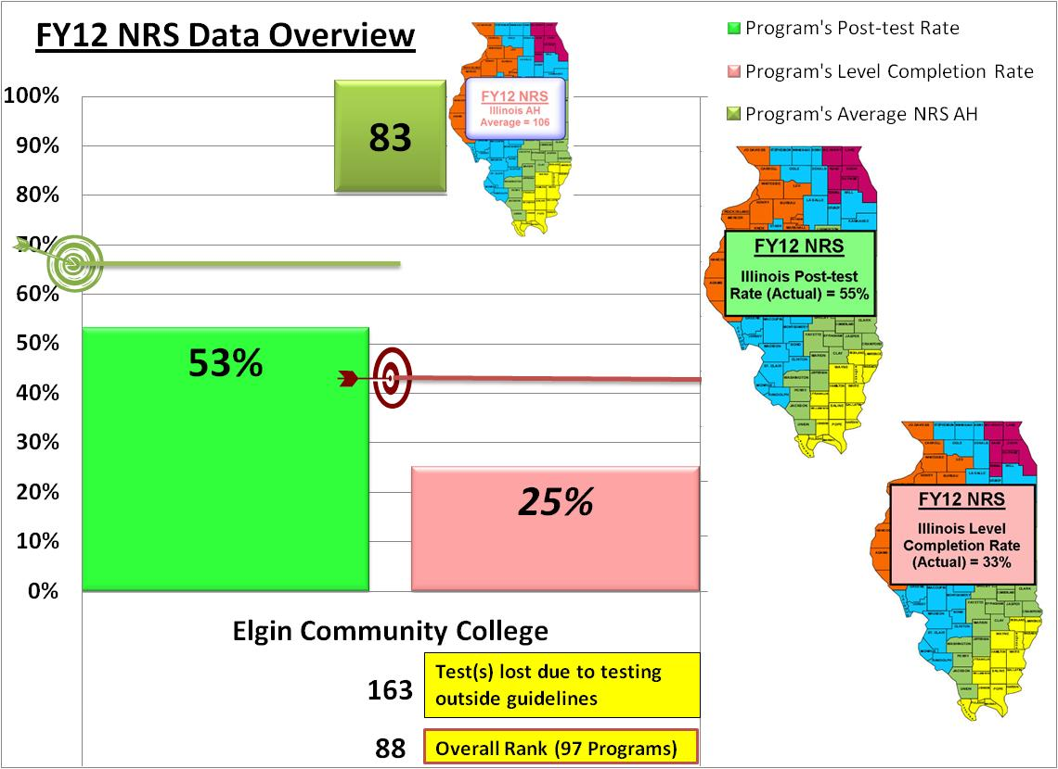
Notes:
Jay to give overview of Snapshot.
Peggy to share local program perspective on Program Snapshot (i.e. Implications, use and next steps).

Slide 14
Next Steps
Have begun to share information with the field
Custom Reporting tools are still under development using methods developed during the ELC
Determining next questions and how information and new analysis tools can fit into larger research agenda
Conduct analysis based on program quartile ranking
Plans to have GED and Post-Secondary information fed directly into system versus data matching through extracts
Our team will present our final results to the adult education field on April 2013 through a presentation at the Illinois statewide Administrator’s Meeting

Slide 15
Contact Information
Peggy Heinrich
Dean of Adult Education
Elgin Community College
Phone: (847) 214-6911
pheinrich@elgin.edu
Jay Brooks
Associate Director for Adult Education and Family Literacy Program and Data System Support
Illinois Community College Board - SICCM Office
Phone: 618.942.7460
jay.brooks@illinois.gov

