Slide 1
LEAP Into WIOA, Part II: NRS Measures and Reporting
NRS Regional Training
October 28, 2016
Day 3

Slide 2
Review of Day 2
Space for entering notes.
Space for expressing concerns.
Stuck with me…
I’m concerned…

Slide 3
Overview of Day 3
Discussion of Financial Table and Narrative
Data Systems
Whole-Group Share-Out
Next steps and NRS support

Slide 4
State Planning Time
Continuation from Day 2

Slide 5
Discussion of Financial and Narrative Reports

Slide 6
Financial Report
Purpose: Reports receipts and disbursements of federal funds, expenditures and unobligated balances by administration, leadership, instruction, and training activities and recipient expenditures.
Use: Allows examination of compliance with budget rules and expenditures and to track expenditures and unobligated balances and recipient share detail
Initial and Final Reports for 1st Year
  Initial due: December 31st 2016
  Final due: December 31st 2017

Slide 7
Federal Financial Report Total Allocation
Added to Federal Share of Expenditures
IELCE (Sec. 243) row
  Separate EL/ Civics financial report eliminated
Institutionalized Persons (Sec. 225)
One-Stop Infrastructure Costs (local option)
One-Stop Infrastructure Costs (state option)

Slide 8
Federal Financial Report Total Allocation (cont’d)
Other Changes
Infrastructure Costs row added to Recipient Share of Expenditures section
New column added for reporting on expenditures on training costs for IET programs

Slide 9
Narrative Report
Purpose: Provides descriptive information about the state program and annual performance for the latest program year in six areas
Use: Allows a narrative, qualitative description of state activities to provide context for data tables and financial report.

Slide 10
Narrative Report Completion and What’s New
Updated to include 6 topics:
  State Leadership Funds (Sec. 223)
  Performance Data Analysis
  Integration with One-stop Partners
  Integrated English Literacy and Civics Education (IEL/CE) Programs (Sec. 243)
  Adult Education Standards
  Programs for Corrections Education and the Education of Other Institutionalized Individuals (Sec. 225)

Slide 11

Questions

Slide 12

Break
Please return in 15 minutes.

Slide 13
Data System Changes

Slide 14
WIOA-Related Data System Changes Needed
New and changed data elements from WIOA
Accommodation for exit and periods of participation
New NRS tables and WIOA reporting
Increased student tracking
  Employment and credential measures
  Data-sharing across agencies
See Handout 8: “Data System Changes, Part 1.”

Slide 15
What are the data elements that need to be added for WIOA data collection and reporting?

Slide 16
Data Element Changes for WIOA
New Data Elements: Barriers to Employment (for Joint ICR)
Displaced homemakers
English language learners, low literacy levels, cultural barriers
Exhausting Temporary Assistance for Needy Families within 2 years
Ex-offenders
Homeless/runaway youth
Long-term unemployed
Low income
Migrants and seasonal farmworkers
Individuals with disabilities
Single parents
Youth in foster care/aged out of system

Slide 17
Changed Data Elements
New age categories
  45-54 and 55-59, replacing 45-59
New employment category
  Employed but notice of termination
New Program Categories
  Participants in integrated education and training program
  Participants in Integrated English Literacy/EL Civics (Sec. 243 programs)

Slide 18
What are the data elements that can be deleted for WIOA data collection and reporting?

Slide 19
Deleted Data Elements
Participant status designations
  Living in rural area, disabled, on public assistance
  Optional participant status designations (from old Table 6)
  Work-based project learner

Slide 20
Transitioning Your Data System to Address New Requirements for Tracking Students

Slide 21
Data System Changes: Tracking Participants Through Periods of Participation
Exit status designation after 90 days
Each period of participation requires the following:
  New demographics and barriers to employment
  Assessment and MSG
  Tracking for employment and wages
  Tracking postexit for credential indicators

Slide 22
Data System Changes: Tracking Participants Through Periods of Participation, cont’d
Identify exclusions.
Identify participants at ninth-grade or higher level.
  For secondary credential measure
  At entry—or through testing level during enrollment

Slide 23
Data System Changes: Tracking Participants and
Exit-Based Outcomes
Need ability to identify and track participants for each period of participation
  Second and fourth quarter postexit employment
  Second quarter median wage calculation
  Employment or postsecondary entry 1 year after exit for secondary credential

Slide 24
Data System Changes: Tracking Participants and
Exit-Based Outcomes, cont’d
Postsecondary entry for MSG (Table 4)
  Requires exit.
  Track until end of program year only.

Slide 25
Data System Changes: New Reporting Needs
New NRS tables
Joint ICR reporting
  Break down by age, ethnicity, sex, and barriers to employment.
State and local reports
  Revise current reports with new measures.
  Develop new reports for monitoring and program improvement.

Slide 26
Tracking and Reporting: Other Changes to Consider for Your Data System
System architecture
  Interagency data coordination for tracking postexit outcomes
  Development of complex data systems
  System security and privacy
Availability of better data analysis tools (21st-century reality)
  Opportunities for improved data use

Slide 27
System Architecture Challenges: Data Coordination Needs
Coordination
of
Agency Data
Consistent student identifiers
Common data definitions
Agreement on data-handling practices

Slide 28
System Architecture Challenges: Developing a Complex Data System
Complex Data Systems
Title II part of larger system
Data system development
  Integrated data system?
  Shared features—e.g., intake form, reports, other?
  Improved interface within/across agencies?
Data sharing at what point along the system?

Slide 29
System Architecture Challenges: Ensuring Security and Privacy
Data Security
and
Personal Privacy
Data ownership
Who is allowed access and can change
Reasonable use and sharing of data
  Individual student records
  Aggregation/disaggregation
  Data linking
Physical and electronic protections

Slide 30
Improvements in Reporting: 21st-Century
Data Tools
Integrate data sets.
Easily create visualizations.
Interact with your data.

Slide 31
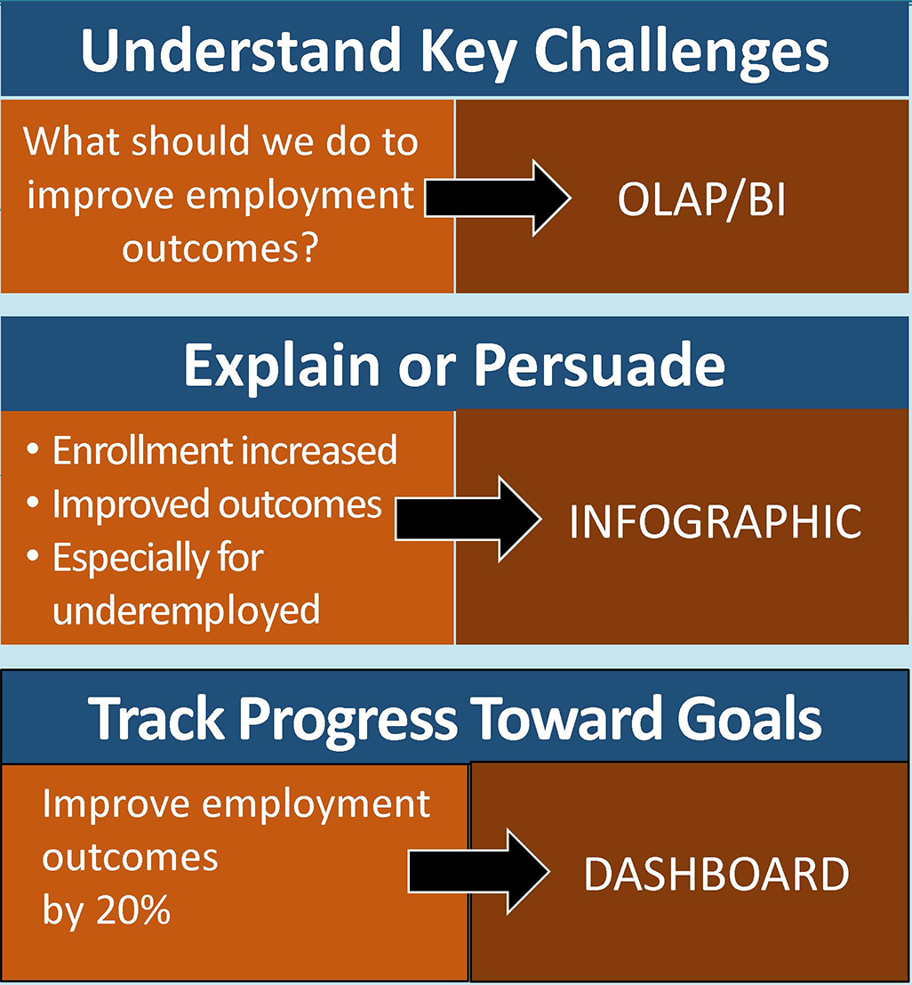

Why Use 21st-Century
Visualization Tools?

Slide 32
Understand Key Challenges
Data Exploration (Business Intelligence) Tools
Cognos
Microstrategy

Slide 33


Explain or Persuade
Infographics

Slide 34
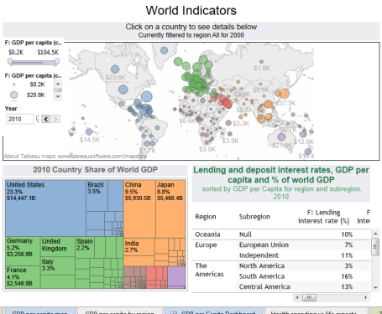
Track Progress
Dashboard Creation Tools
MS Excel
Tableau

Slide 35
Cross-State Sharing

Slide 36
World Café Topics
How can we manage the increased burden of student tracking?
What databases can we use to obtain follow-up data (employment, follow-up for participants who earn a credential)?
What implications does period of participation have for tracking participants? For local programs?
What reports do state and local staff need to effectively manage data?
How do we communicate data system changes to local programs?

Slide 37

Lunch
Please return in 1 hour

Slide 38
Planning for Data System Changes and Use

Slide 39

Reports and Data Tools

Slide 40
Using Your Data
Think about the changes to the NRS tables that we have reviewed.
Use the Outputs-Inputs-Functionality process to consider how else you can use the data from these tables to help improve your adult education program.
  What does the NRS table data tell you?
  What else do you want to know?
  How can you use the data to help answer these questions?
  What reports do you need/want?
  What information do you need/want?
See Handout 8: “Data System Changes, Part 2.”

Slide 41
State Action Step Planning

Slide 42
Setting Action Steps by Role
Review your NRS State Planning Tool.
Begin to set action steps based on your role as a state data or professional development specialist:
    Identify what tasks need to be completed for implementation.
    Determine the action steps needed.
    Identify who is responsible.
    Indicate what resources are needed to support the action steps.
    Indicate a time line for completion.
See Handout 9: “Action Planning Template.”

Slide 43
Whole-Group Share-Out

Slide 44

Visualizing Your Next Step
Select one image that best represents your immediate next steps.
  Select the image through the lens of your role (data specialist, state director, professional development specialist).
Volunteers will share their images.

Slide 45
Discussion of NRS Project Support

Slide 46
Upcoming NRS Activities
Webinars
Tools and Training (Task 3)
Targeted Training (February 2017)

Slide 47

Safe Travels!

