Slide 1
LEAP Into WIOA, Part II: NRS Measures and Reporting
NRS Regional Training
October 27, 2016
Day 2

Slide 2
Review of Day 1
Space for entering notes.
Space for expressing concerns.
Stuck with me…
I’m concerned…

Slide 3
Overview of Day 2
NRS Tables 4-5
NRS Tables 6, 7, 8, 9, 10, and 14
Time Line for Reporting
Cross-State Sharing
State Planning Time

Slide 4
NRS Table Changes
Tables 4, 4b, and 5

Slide 5
Table 4. Measurable Skill Gains, by Entry Level
Purpose: Provides participant numbers and rates of MSG, broken down by EFL and for periods of participation.
MSG is broken down into educational functioning–level gain and secondary credential.
Provides participant retention (number separated and remaining), broken down by EFL.
Use: Provides performance data on MSG by type, and by EFL level and period of participation; allows examination of participant flow by level.

Slide 6
Table 4, cont’d
How to complete the table:
Use participants’ EFL at initial period of participation.
Record in the EFL column the number of participants with the following:
Pre-posttesting gains
Completion of Carnegie Units, entered postsecondary education or training after exit

Slide 7
Table 4 (continued)
How to complete the table:
Record number, obtaining secondary credential.
Secondary credential attainment and postsecondary entry must occur by end of program year (June 30).

Slide 8
Table 4, cont’d
How to complete the table:
Only one gain can be counted per participant per period of participation
Columns B through H are unduplicated counts.
Report number of periods of participation and total number of outcomes per period and EFL level.

Slide 9
Period of Participation Reporting: Example for Table 4
Entering Educational Functioning Level | Total Number Enrolled | Total Attendance Hours for All Participants | Number Who Achieved at Least One Educational Functioning Level Gain | Number Who Attained a Secondary School Diploma or Its Equivalent | Number Separated Before Achieving Measurable Skill Gains | Number Remaining in Program Without Measurable Skill Gains | Percentage Achieving Measurable Skill Gains | Total Number of Periods of Participation | Total Number of Periods of Participation With Measurable Skill Gains | Percentage of Periods of Participation With Measurable Skill Gains
(A) | (B) | (C) | (D) | (E) | (F) | (G) | (H) | (I) | (J) | (K)
ABE Level 1 | 100 | 4000 | 38 | 12 | 20 | 30 | 50% | 110 | 52 | 47%
ABE total
ESL Level 4 | 200 | 20000 | 100 | 20 | 40 | 40 | 60% | 220 | 125 | 57%
ESL total
Grand total | 300 | 24000 | 138 | 32 | 60 | 70 | 57% | 330 | 177 | 54%

Slide 10
Table 4: What’s New
Column is added for secondary credential.
Columns are added to record number of periods of participation and outcomes in periods.
Column to record more than one EFL gain is deleted.

Slide 11
Table 4. Period of Participation and MSG: Carmen
Carmen became a participant in September in ESL Level 4. She attended until the class ended in November, achieved a level gain, but then never returned.
Carmen has one EFL gain, reported in Column D and Column J (Table 4).
Carmen has one period of participation, reported in Column I.
September to November = 1 period of participation (determined 90 days after exit).

Slide 12
Table 4. Period of Participation and MSG: Tony
Tony enrolled in September but left after 10 hours. He returned in November but dropped out in December, after 40 contact hours. He returned in April, posttested in June and showed a level gain, and then exited that same month.
Tony has one EFL gain, reported in and Column J.
He has two periods of participation, reported in Column I.
Sept. to Dec. = 1 period of participation (determined 90 days after exit).
April to June = 1 period of participation (determined 90 days after exit).

Slide 13
Table 4. Period of Participation and MSG: Christopher
Christopher became a participant in ABE Level 4 in October, achieved an EFL gain, and then dropped out in December. He returned in April, passed the GED tests in June to get his secondary credential, and exited.
Christopher has an EFL gain and obtained a secondary credential.
EFL is reported in Column D (unduplicated) and J (for 1st PoP). The Secondary credential is reported in Column J (duplicated)
He has two periods of participation, reported in Column I.
October to December = 1 period of participation (determined 90 days after exit).
April to June = 1 period of participation (determined 90 days after exit).
He had two MSGs, one in each period of participation.

Slide 14
Table 4: Assessment and Periods of Participation
Participant must be placed in appropriate EFL every period of participation.
May change from prior period, on the basis of the pretest.
Policy and procedures for assessing students should not change because of period of participation.
Good assessment practices should always be followed.

Slide 15
Table 4: Assessment and Periods of Participation, cont’d
Assessments may carry over to new periods of participation if student returns before test has “expired.”
That is, time has not exceeded the publishers’ guidelines for retesting.
If the publisher does not have retesting guidelines, the state must establish a policy for retesting time that local programs must follow.
Retesting policy must be based on sound assessment practice.

Slide 16
Retesting and Periods of Participation
If the test has expired according to publisher or state policy:
Participant must be retested, with no carryover from the prior period of participation.
A new period of participation is recorded, using the results of the new assessment:
EFL at second period of participation may differ from that at first period of participation.
EFL for first period of participation is recorded in Column B.
EFL for second period of participation is recorded in Column I.

Slide 17
Retesting and Periods of Participation, cont’d
If the test has not expired according to publisher or state policy
Participant does not need to be retested, and EFL placement can carry over from prior period and be reported in Column I.
The next valid posttest given may be used to determine EFL gain in the new period of participation and, if achieved, reported in column J for the second period (not first)
Assessment results may not be used for EFL achievement once a period of participation has ended.

Slide 18
Retesting, Period of Participation: Tony
Tony enrolled in September but left after 10 hours. He returned in November but dropped out in December, after 40 contact hours. He returned in April and posttested with a level gain in June, when he exited.
If Tony was pretested in September, his test can be reused in November for placement and reporting.
He must be retested for placement in April if his September test is beyond the retesting time set by state policy and has expired.

Slide 19
Retesting, Period of Participation: Christopher
Christopher became a participant in October in high-intermediate ABE, achieved an EFL gain but dropped out in December. He returned in April and passed the GED tests in June, to get his secondary credential, and exited.
If not expired according to the publisher or state policy, Christopher’s posttest in December can be used for placement in April.

Slide 20
Table 4b. EFL and Attendance, by Pre- and Posttested Participants
Purpose: Provides number of participants who were both pre- and posttested and their EFL gains, by level.
Use: Provides information on pre- and posttesting rates that can be used to assess rates of EFL gain based on testing.

Slide 21
Table 4b, cont’d
How to complete the table:
Use participant status at initial entry.
Include only participants who were both pre- and posttested.
Report unduplicated count of all participants.
Use first valid posttest after initial placement.

Slide 22
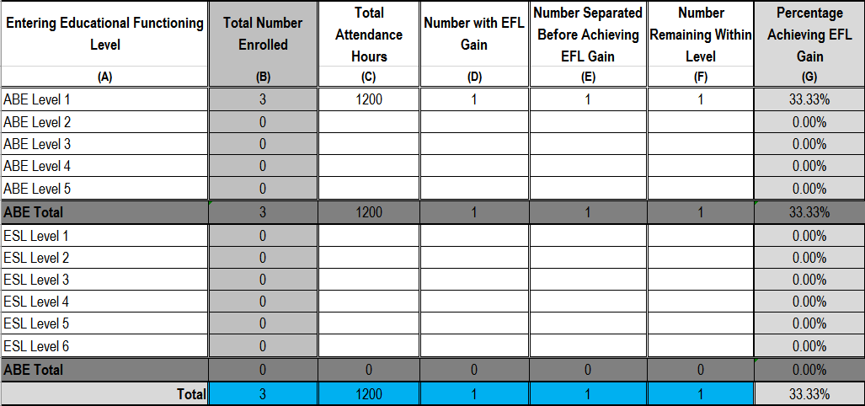
Table 4b. EFL and Attendance, by Pre- and Posttested Participants

Slide 23
Table 4b: What’s New
No changes—same as original Table 4b

Slide 24
Changes in Action
A participant has one period of participation with an MSG. The same participant has another period of participation with an exit but no MSG.
Are both periods of participation recorded? Why or why not?
Scenario: Carlos enrolled in ABE Level 5 in September, achieved an EFL gain, then left in November. He returned in January, exited in May, and entered a postsecondary program.
What MSG does he have? How many periods of participation?
Where would these be reported?
See Handout 6: “NRS Table Changes in Action.”

Slide 25
Break Please return in 15 minutes.

Slide 26
Table 5: Core Follow-up Outcome Achievement
Purpose: Provides WIOA performance indicator rates by participants and periods of participation
Use: Shows a record of state performance on WIOA indicators used for performance targets. Performance rates are used to populate the joint Statewide Performance template.

Slide 27
Table 5:
How to complete
Includes only exited participants:
Employment measures: all exiters
Median earnings: exiters employed in second quarter after exit
Secondary credential: at ninth grade or higher level at entry or during enrollment
Postsecondary credential: exiters who were co-enrolled in postsecondary education, including IET programs
Note that exclusion may apply to exit-based indicators, see Exclusions discussion

Slide 28
Table 5, cont’d
How to complete the table (continued):
Includes different group of participants from those in all other tables
Because of follow-up time, participants attended in prior years
Other tables include participants from same year only
Time lag for reporting up to 1 year after exit:
Employment measures must also account for time lag for UI database.
No data will be reported in PY 2016 report.
Partial data will be reported in 2017 report; full data will be reported in 2018 report.
More on this later!

Slide 29
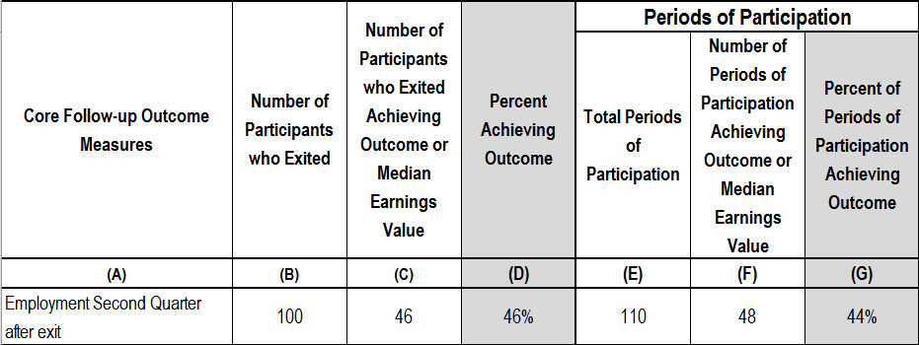
Period of Participation Reporting: Example for Table 5

Slide 30
Table 5: What’s New
Outcomes changed to WIOA-required measures.
Rows and columns for sampling eliminated.
Rows and columns for number used for data matching or survey eliminated.
Response rate irrelevant: Overall rate calculated for all nonexcluded participants.
Number and outcomes, by period of participation, reported.

Slide 31
Table 5: Christopher
Christopher became a participant in October 2015 in ABE Level 4 (former high intermediate ABE), achieved an EFL gain but dropped out in December 2015. He returned in April 2016 and passed the GED tests in June 2016 to get his secondary credential and exited.
Christopher has two periods of participation and must be followed up for employment indicators both
October to December 2015 AND
April to June 2016

Slide 32
Table 5: Christopher, cont’d
Employment
must be checked second (April-June) and fourth (October- December) quarters after exit for Period I; and
must be checked second (October-December) and fourth (April-June) quarters after exit for Period II.

Slide 33
Table 5: Christopher, cont’d
Median earnings
If Christopher was employed in second quarter after exit from either or both periods, he will be included in median wage calculation.
Credential Indicators
Christopher moved into the ABE Level 5 (ninth-grade equivalent or above) during the first period of participation, and he began the second period of participation at that level. He is included in the credential measure denominator for both periods of participation.
He received his GED in the second period of performance, but must be employed or have entered into postsecondary education within 1 year after exit to count in the numerator.

Slide 34
Table 5a. Core Follow-up Outcome Achievement for Participants in Distance Education
Purpose: Provides WIOA performance indicators for distance education participants, unduplicated and by periods of participation.
Use: Examine performance on WIOA indicators of distance education students; allows comparison with performance of other participants.

Slide 35
Table 5a: What’s New
Same as Table 5!
Outcomes changed to WIOA-required measures.
Rows and columns for sampling eliminated.
Rows and columns for number used for data matching or survey eliminated.
Response rate irrelevant: Overall rate calculated for all nonexcluded participants.
Number and outcomes, by period of participation, reported.

Slide 36
Changes in Action
Scenario: Bob enrolls in September and exits in December. He re-enrolls in April and exits in June.
When should second quarter employment be collected?
See Handout 6: “NRS Table Changes in Action.”

Slide 37
Cross-State Sharing

Slide 38
World Café
What is a World Café?
A café conversation is a creative process for leading collaborative dialogue, sharing knowledge, and creating possibilities for action.
What’s the process?
4-6 people at each table to focus on and discuss a relevant topic
3 rounds, 20 minutes each
At the end of rounds, each member of the group moves to a new table.
Short whole-group debriefing

Slide 39
World Café Topics
Table 4: How will you address periods of participation?
NRS Table 4: How will you address reporting gains?
NRS Table 4: How will you address duplicated and unduplicated counts?
NRS Table 5: How will you address the outcome changes required by WIOA?
NRS Table 5a: How will you address changes in distance education data collection?
What professional development needs will locals have for Tables 4 and 5?
What are the data system changes needed to address Table 4 and 5 changes?

Slide 40
Lunch Please return in 1 hour

Slide 41
Time Line for Reporting Exit-Based Indicators

Slide 42
Exit-Based Indicators (Table 5)
Has different time periods and participants from those of other tables.
Based on exit quarter of indicator.
Will take 3 program years to get full data.
No reporting for Table 5 for Program Year (PY) 2016 (2017 report)
Two quarters (50%) for fourth-quarter employment and credential for PY 2017 (2018 report)
Full data for PY 2018 (2019 report)
Credential measure and fourth quarter employment reported for a calendar year (not program year) starting in 2018.
January-December, 2 years prior to current program year.
Will include parts of 2 program years.

Slide 43
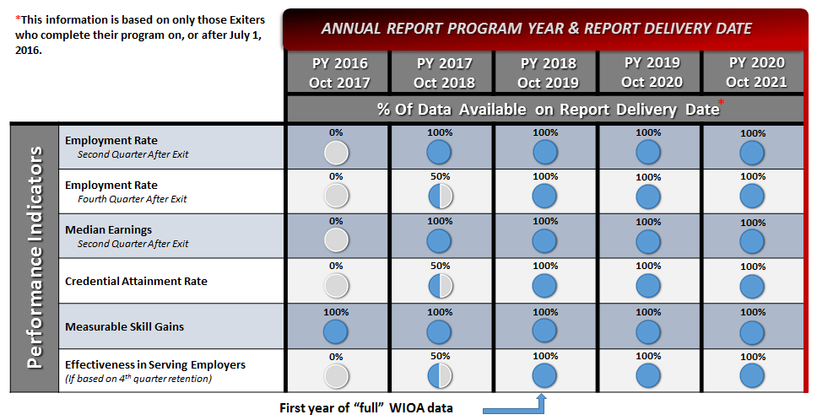
Data Coverage, by Reporting Year

Slide 44
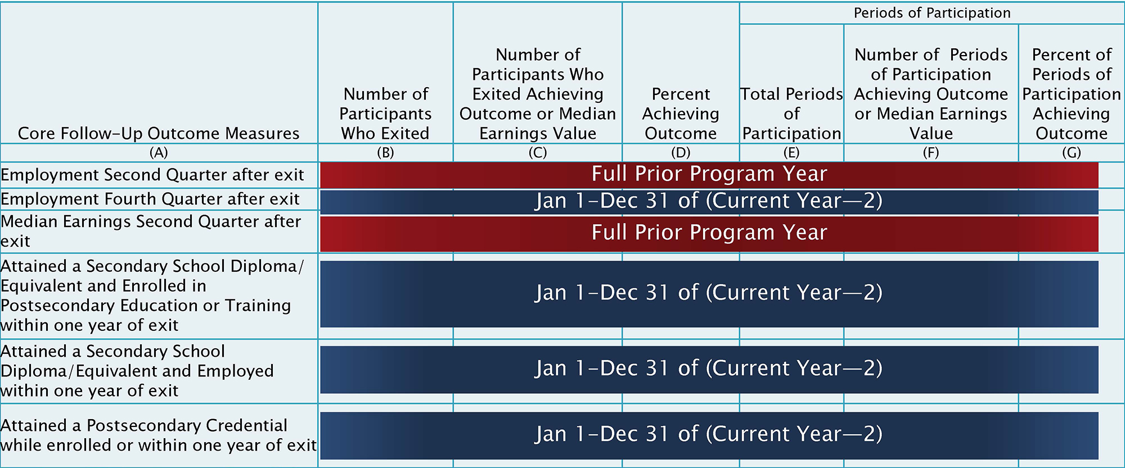
NRS Table 5. Coverage Dates for Annual Report

Slide 45
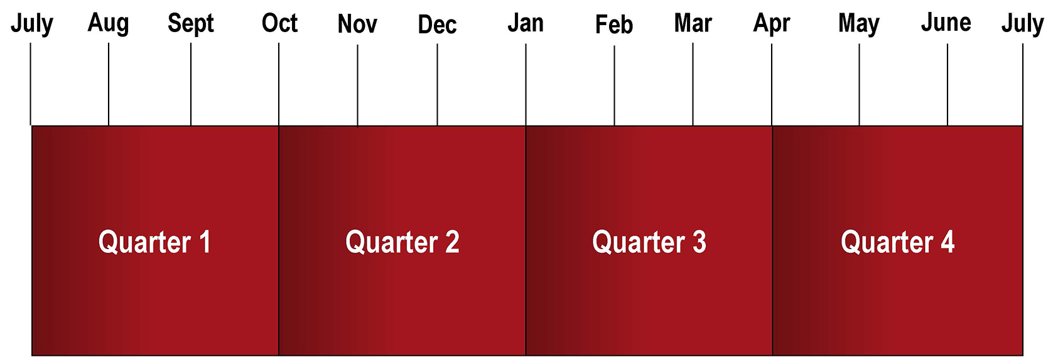
Reporting Quarters

Slide 46
Employment Measure Time Line
For a Learner Exiting in the First Quarter

Slide 47
Employment Measure Time Line
For a Learner Exiting in the First Quarter

Slide 48
Employment Measure Time Line
For a Learner Exiting in the First Quarter

Slide 49
Reporting Second-Quarter Employment and Median Earnings
For Program Year 2016

Slide 50
Reporting Second-Quarter Employment and Median Earnings
For Program Year 2016

Slide 51
Reporting Second-Quarter Employment and Median Earnings
For Program Year 2016

Slide 52
Reporting Second-Quarter Employment and Median Earnings
For Program Year 2016

Slide 53
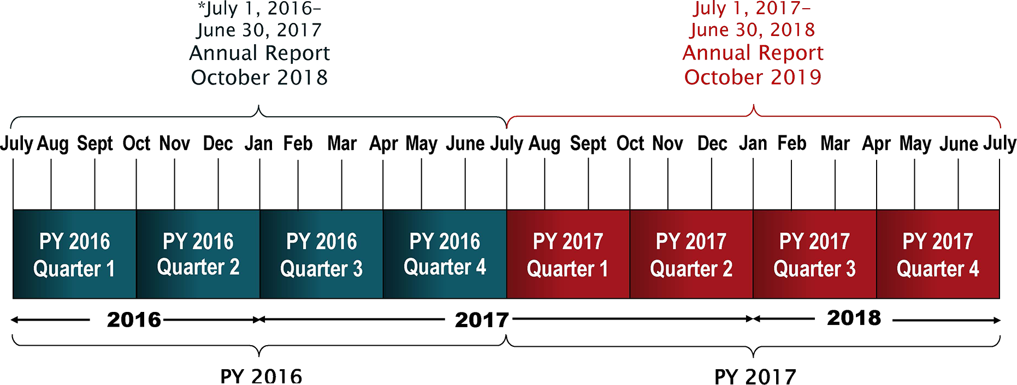
Second-Quarter Employment and Median Earnings Reporting Time Lines
For Program Years 2016 and 2017

Slide 54
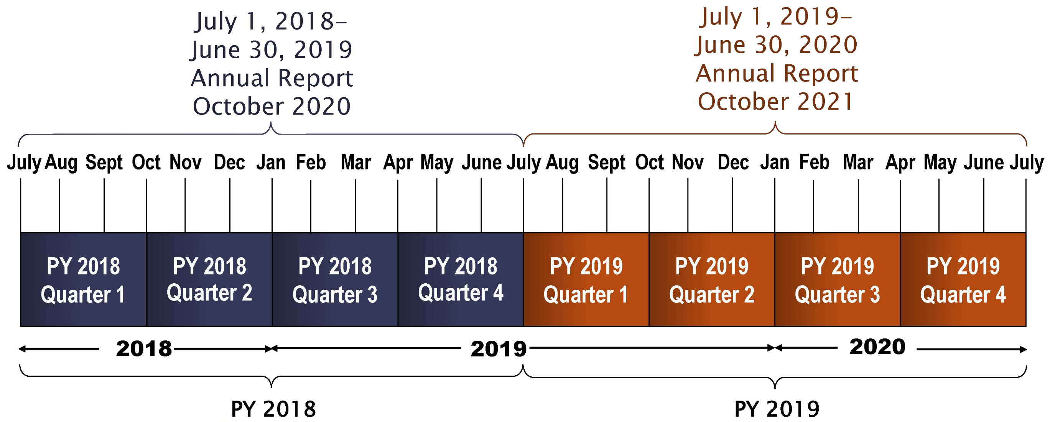
Second-Quarter Employment and Median Earnings Reporting Time Lines
For Program Years 2018 and 2019

Slide 55
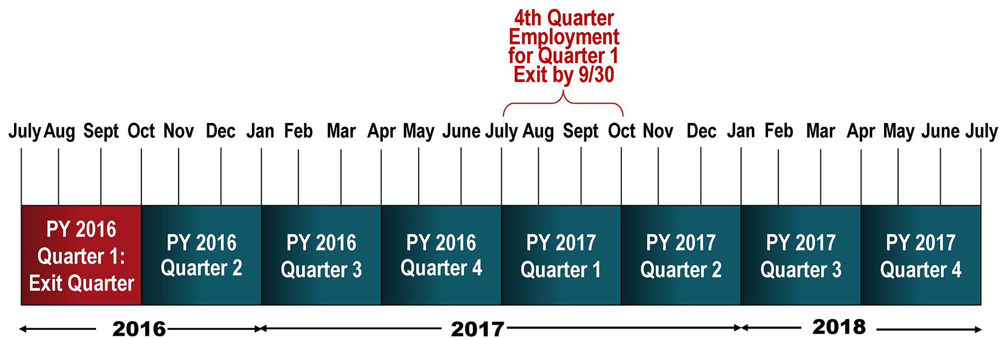
Reporting Fourth-Quarter Employment and Credential Indicator
For Program Year 2016

Slide 56
Reporting Fourth-Quarter Employment and Credential Indicator
For Program Year 2016

Slide 57
Reporting Fourth-Quarter Employment and Credential Indicator
For Program Year 2016

Slide 58
Reporting Fourth-Quarter Employment and Credential Indicator
For Program Year 2016

Slide 59
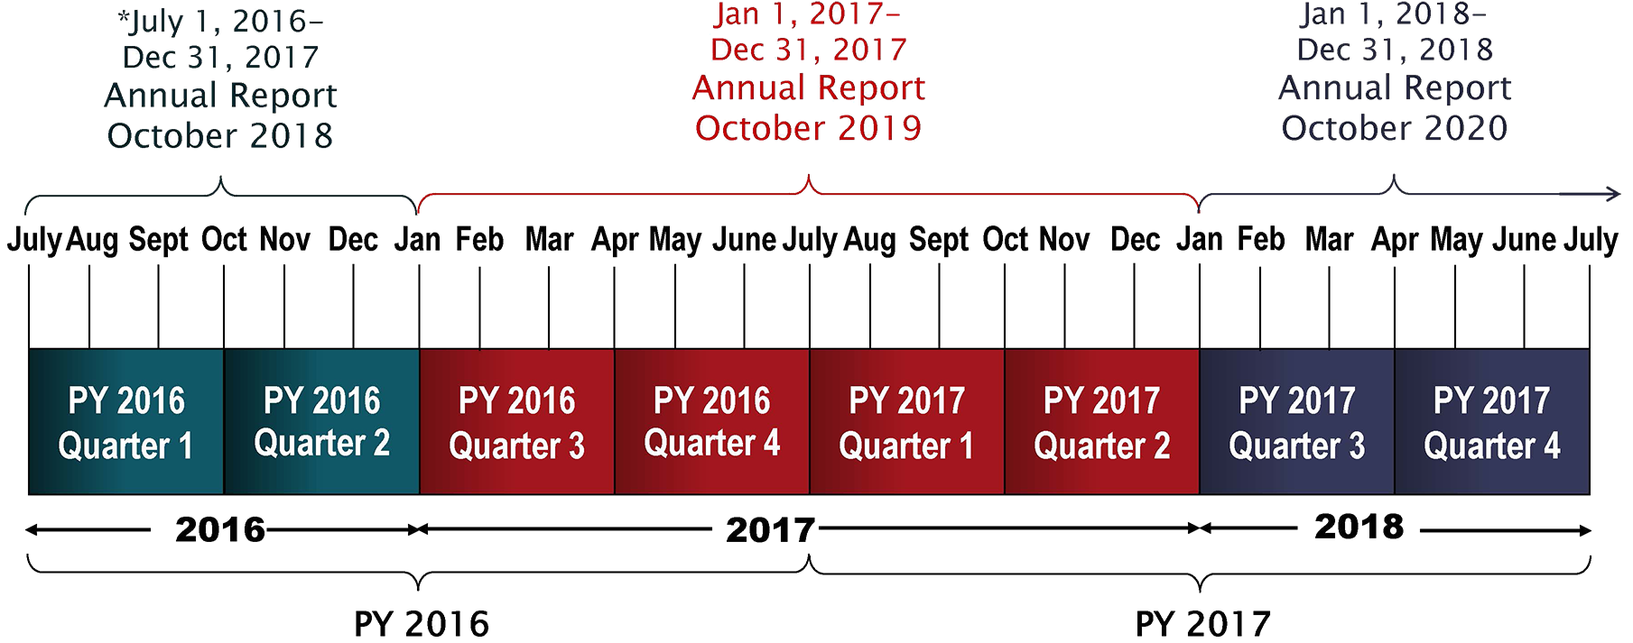
Fourth-Quarter Employment and Credential Indicator Reporting Time Lines
For Program Years 2016 and 2017

Slide 60
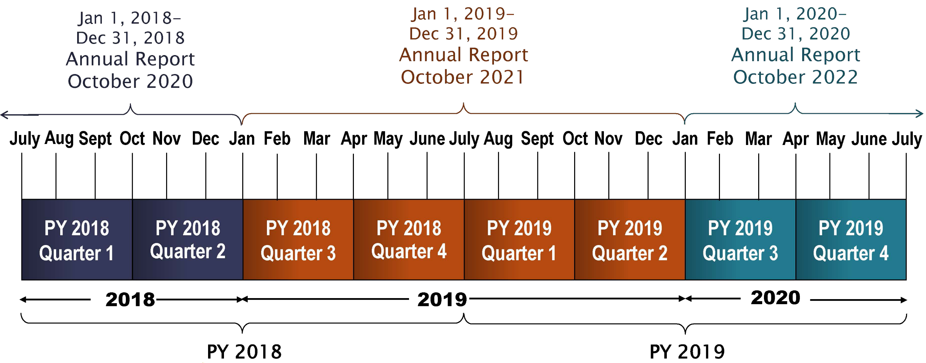
Fourth-Quarter Employment and Credential Indicator Reporting Time Lines
For Program Years 2018 and 2019

Slide 61
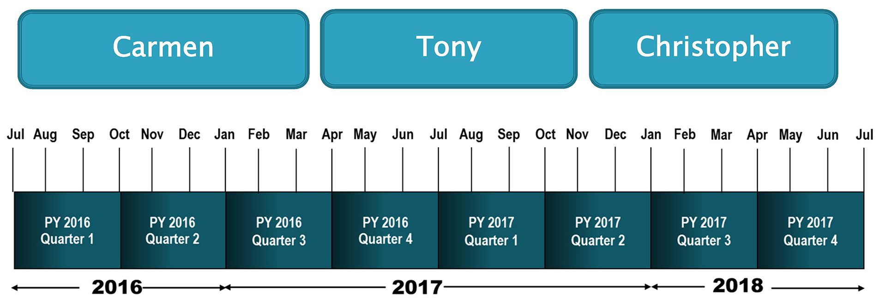
Reporting Time Line Activity
See Handout 7: “Who, What, When.”

Slide 62
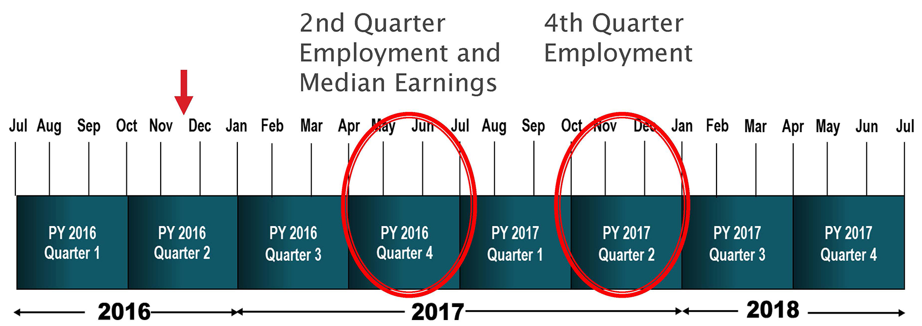
Reporting: Carmen

Slide 63
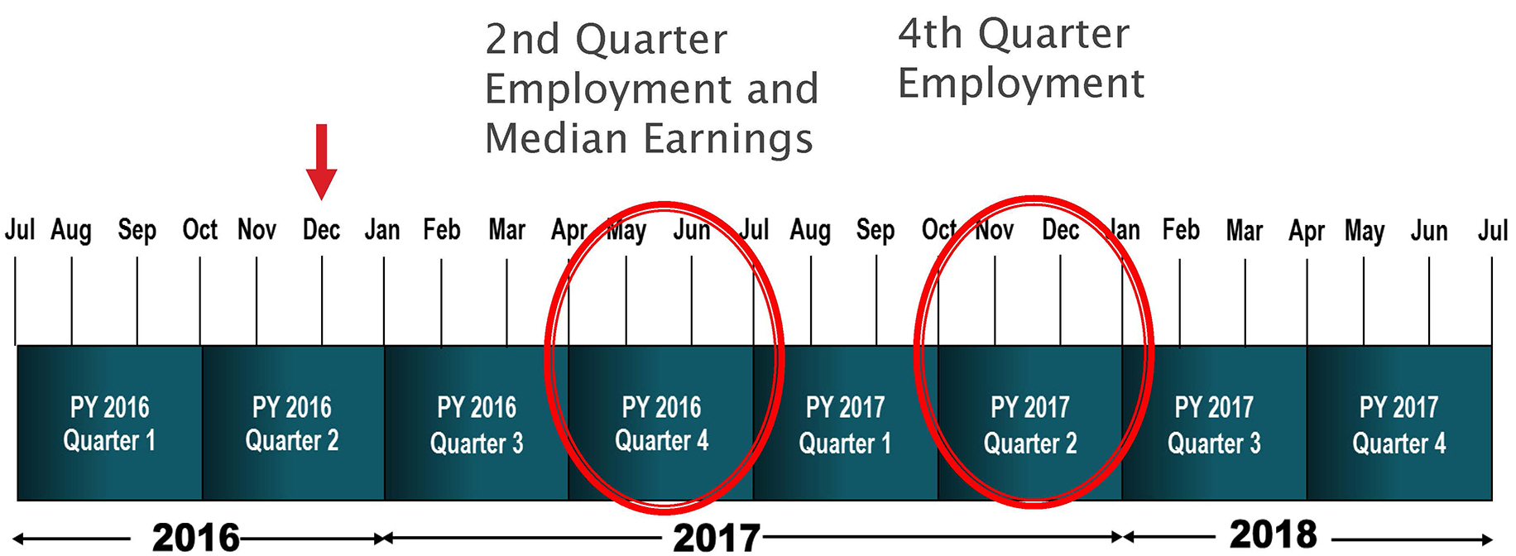
Reporting: Tony, PoP #1

Slide 64
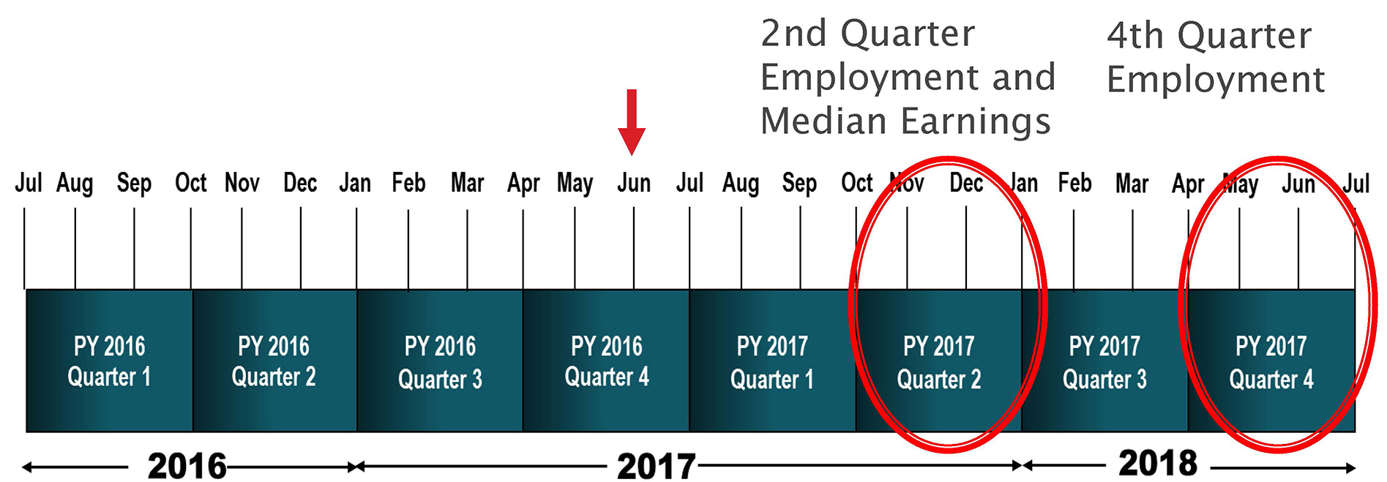
Reporting: Tony, PoP #2

Slide 65
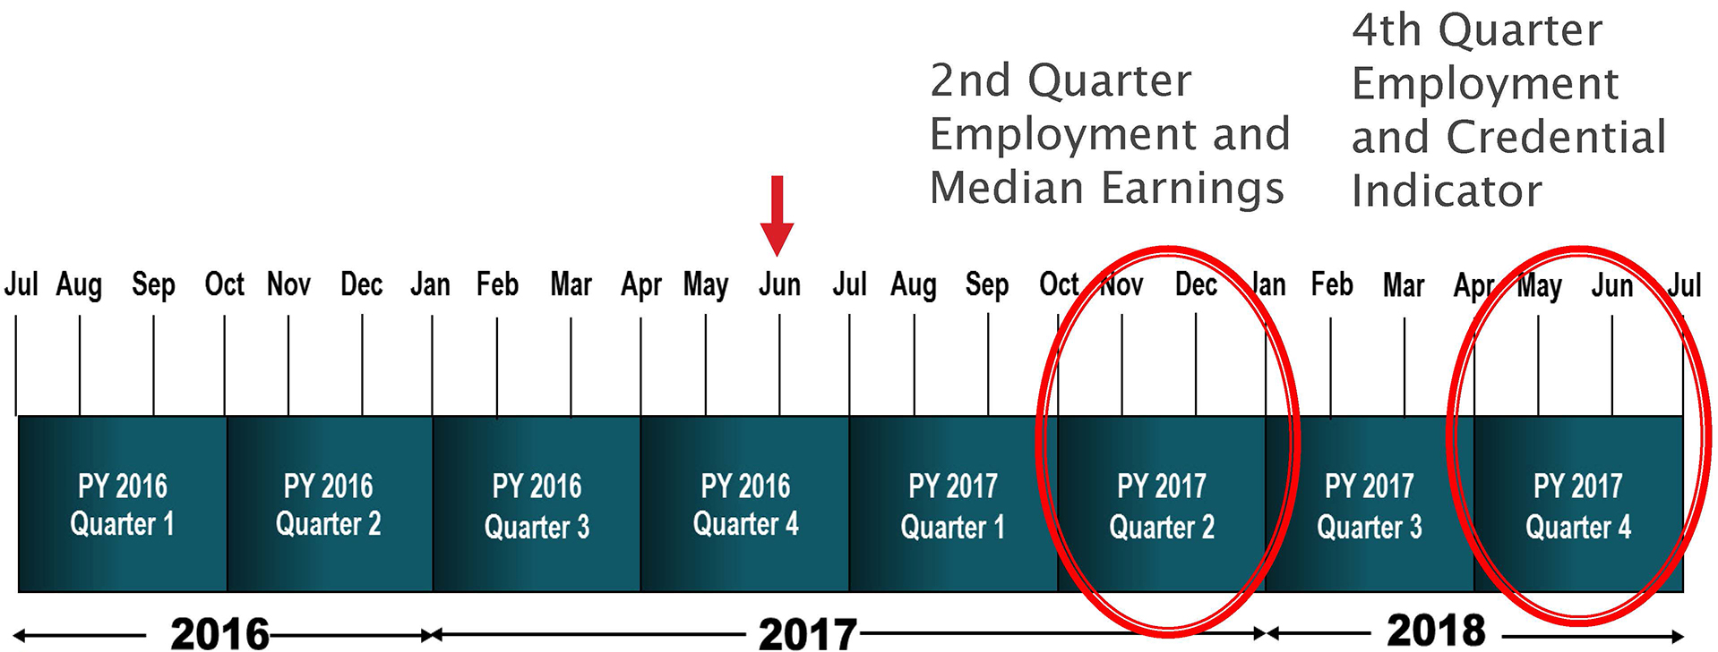
Reporting: Christopher

Slide 66
Program Year 2016 Joint Reporting

Slide 67
Program Year 2017 Joint Reporting

Slide 68
Program Year 2018 Joint Reporting

Slide 69
Program Year 2019 Joint Reporting

Slide 70
Summary: Who to Track After Exit

Slide 71
State Planning

Slide 72
State Planning Time, Part A
Focus on the table changes and reporting requirements presented.
Identify the impact of these changes in relation to the six elements presented in your tool:
Intake
Broader assessment (MSG)
Follow-up
Data systems
Program monitoring
Training, communication, and leadership
What questions will the locals have?
See Handout 1: “LEAP, Part II: Support Tool.”

Slide 73
State Planning Time, Part B
Focus on how you are going to communicate with locals about table changes.
You will develop responses to questions formulated in the previous planning activity, according to your role in the state.
Activity outcome:
We will compile teams’ work into a “Ready-to-Use FAQ Packet” and all states can benefit from the shared materials.

Slide 74
Break Please return in 15 minutes.

Slide 75
NRS Table Changes
Tables 6, 7, 8, 9, 10, and 14

Slide 76
Table 6. Participant Status and Program Enrollment
Purpose: Reports participant employment, prior education, and number enrolled in instructional programs and institutional settings.
Use: Provides statewide description of participant employment status and past education in the United States and abroad; provides data on enrollment in institutions.

Slide 77
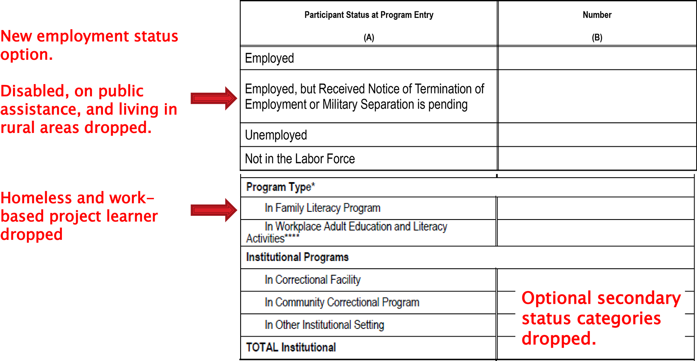
Table 6. Participant Status and Program Enrollment: What’s New

Slide 78
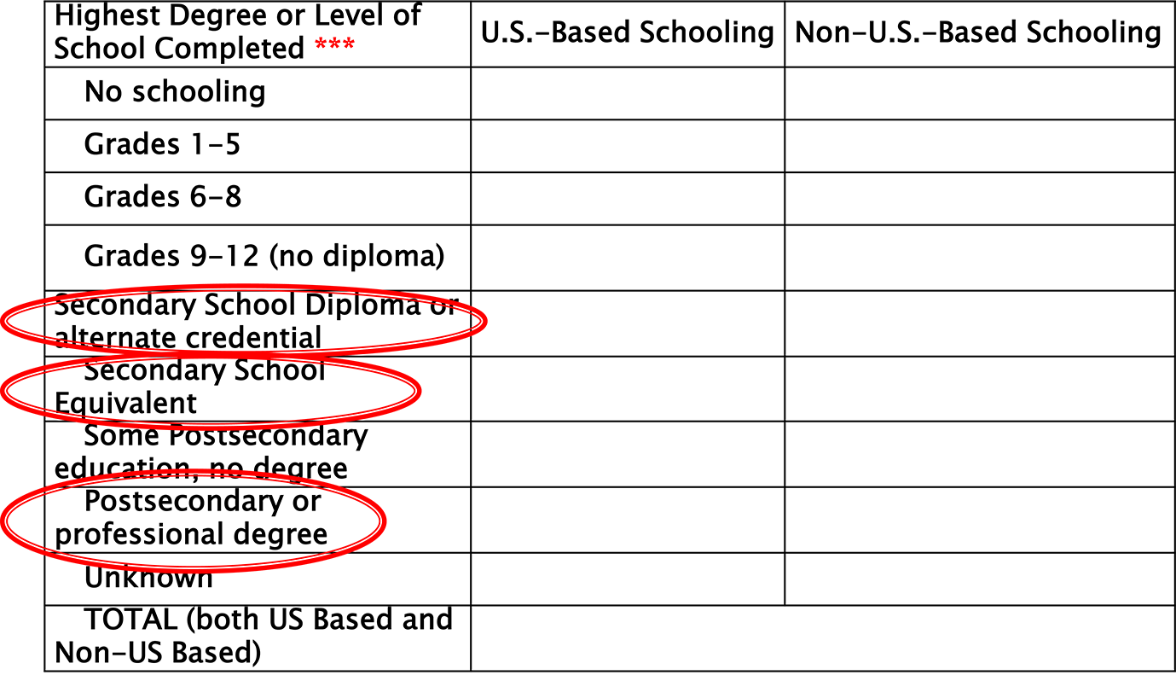
Table 6. Participant Status and Program Enrollment: What’s New (continued)

Slide 79
Table 6, cont’d
How to complete the table:
Report employment status at initial entry.
Report highest level of schooling or degree attained for each participant in U.S.- or non-U.S.-based schooling. Total must be same as reported in Table 1.
Report number of participants at entry for program type and institution categories.
Designated program must be specifically designed for that purpose.
No duplicate counting.

Slide 80
Table 6: What’s New
New employment status option
Participant categories dropped
Terminology changes

Slide 81
Table 7: Adult Education Personnel, by Function and Job Status
Purpose: Reports types of state adult education program and local staff, including teachers, full- and part-time personnel, and volunteers.
Use: Provides picture of adult education state and local staff and teachers.

Slide 82
Table 7, cont’d
How to complete the table:
Function:
Report unduplicated count of personnel by function and job status.
Count the number of positions, not the number of staff who filled them.
Count once each part-time position under the Adult Education and Family Literacy Act that is being paid out of federal, state, and/or local education funds.
Count once each full-time position of the program administered under AEFLA who is being paid out of Federal, State, and/or local education funds.

Slide 83
Table 7, cont’d
How to complete the table:
Teachers:
Report the number of teachers, not the number of positions.
Do not report adult education experience and certification for volunteers.
The total number of teachers for which experience is reported must equal the total number of teachers reported.
Report all certifications (duplicates possible).

Slide 84
Table 7: What’s New
No changes

Slide 85
Table 8. Outcomes for Adults in Family Literacy Programs (Optional)
Purpose: Reports WIOA performance measures, including MSG and optional family literacy–related measures.
For reporting family literacy participants only—optional
Use: Allows comparison of performance of family literacy participants with others.

Slide 86
Table 8, cont’d
How to complete the table:
Complete in the same way as Table 5.
MSG completed similarly to Table 4
Optional measures are collected by survey after exit.
Number and types of increased involvement in children’s education and literacy activities

Slide 87
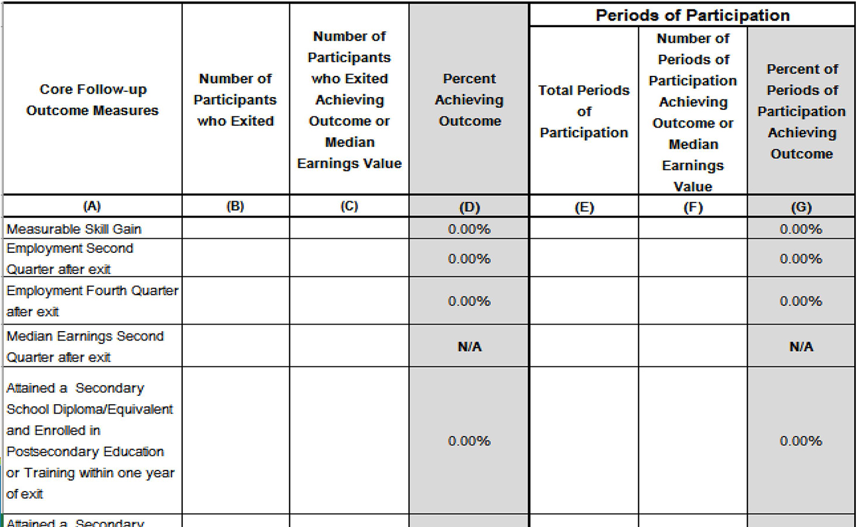
Table 8. Outcomes for Adults in Family Literacy Programs (Optional)

Slide 88
Table 8: What’s New
Identical to new Table 5 but with a row added for Measurable Skill Gains

Slide 89
Table 9. Secondary Outcome Measures (Optional)
Purpose: Reports performance on non-WIOA-required outcomes important to adult education—optional.
Use: Provides data to examine performance on “softer” (not required) measures.

Slide 90
Table 9, cont’d
How to complete the table:
Report number of participants and outcomes by survey after exit on the following:
left public assistance
achieved citizenships skills
increased involvement in children’s education
voting or registered to vote
increased community involvement

Slide 91
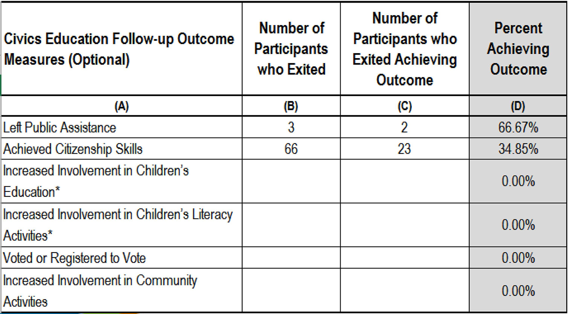
Table 9. Secondary Outcome Measures (Optional)

Slide 92
Table 9: What’s New
Identical to former Table 11 but Eliminates work-based project learner category.

Slide 93
Table 10. Outcome Achievement for Adults in Correctional Education Programs
Purpose: Reports WIOA performance measures, including MSG for correctional education participants
Use: Allows examination and comparison of performance of correctional education participants with others

Slide 94
Table 10. Outcome Achievement for Adults in Correctional Education Programs
How to complete the table:
Complete in the same way as Table 5.
MSG completed similarly to Table 4

Slide 95
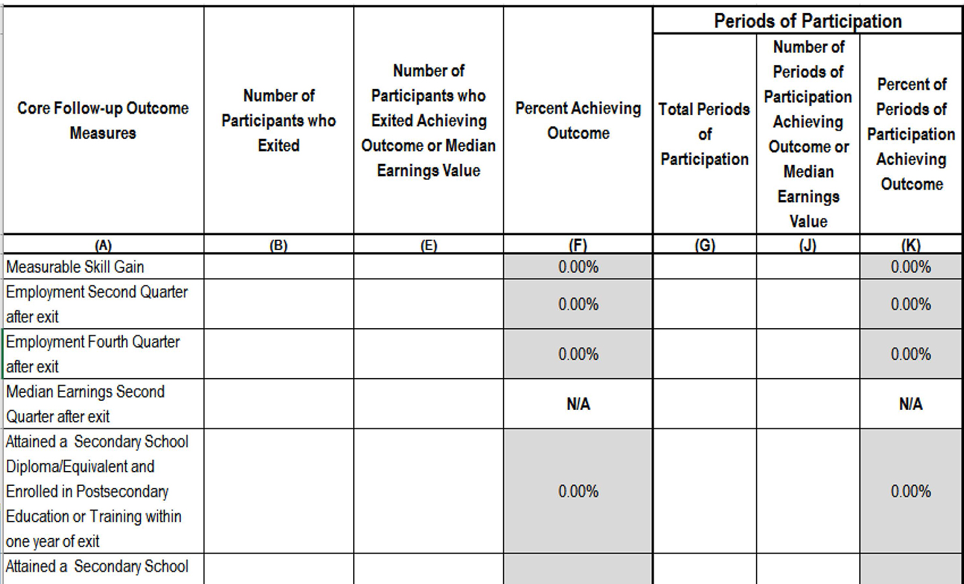
Table 10. Outcome Achievement for Adults in Correctional Education Programs

Slide 96
Table 10: What’s New
Identical to new Table 5 but with a row added for Measurable Skill Gains

Slide 97
Table 14. Local Grantees, by Funding Source
Purpose: Reports number of providers and subrecipients by WIOA and non-WIOA funding sources.
Use: Allows examination of distribution of funds, by source and subrecipient.

Slide 98
Table 14, cont’d
How to complete the table:
Report number of providers giving instruction services in each category, funding, and source.
IET/EL Civics may be a subset of providers.

Slide 99
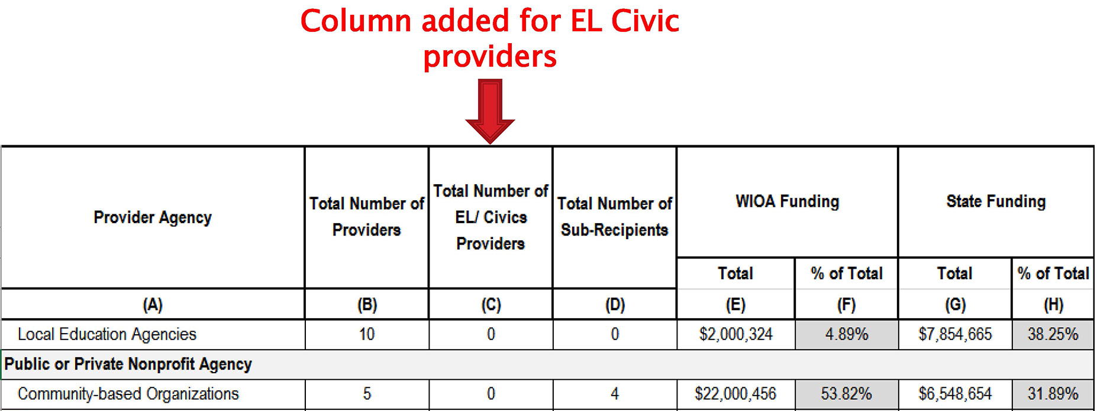
Table 14: What’s New

Slide 100
Table 14: What’s New
New column for EL Civics

Slide 101
Changes in Action
Part 1:
In your state team, create a question scenario on your assigned NRS table (if X, what happens?)
Provide a response to your question
Part 2:
Switch scenarios with your assigned group. Teams should solve the new scenarios. Once both teams have come up with an answer to the other’s scenario, discuss to determine if anything is missing.
See Handout 6: “NRS Table Changes in Action.”

Slide 102
State Planning

Slide 103
State Planning Time, Part A
Focus on the table changes and reporting requirements presented.
Identify the impact of these changes in relation to the six elements presented in your tool:
Intake
Broader assessment (MSG)
Follow-up
Data systems
Program monitoring
Training, communication, and leadership
What questions will the locals have?
See Handout 1: “LEAP, Part II: Support Tool.”

Slide 104
State Planning Time, Part B
Focus on how you are going to communicate with locals about table changes.
You will develop responses to questions formulated in the previous planning activity, according to your role in the state.
Activity outcome:
We will compile teams’ work into a “Ready-to-Use FAQ Packet” and all states can benefit from the shared materials.

Slide 105
Wrap-Up

Slide 106
Day 3: Overview
Discussion of Financial Table and Narrative
Data Systems
State Planning
Whole-Group Share-Out
Next Steps & NRS Support

Slide 107
Day 2: Reflection—What Stuck With You?

