Slide 1
LEAP Into WIOA, Part II: NRS Measures and Reporting
September/October 2016

Slide 2
Welcome and Overview of the Training
OCTAE and NRS Support Project

Slide 3
What Is LEAP?
Learn about the Workforce Innovation and Opportunity Act (WIOA) and the new measures.
Explore what it means for your state adult education program.
Assess your situation and what you may or may not have in place.
Plan for implementation of your state plan.

Slide 4
LEAP Into WIOA, Parts I & II
New NRS measures under WIOA
Change Style Indicator
Leadership during change
Evaluating state data systems
Communicating change to stakeholders
Implementing your state plan
Accountability under WIOA
Measures
NRS table changes
Data system changes
Planning for and communicating NRS changes
Follow-up to LEAP, Part I
Part I: Preparing for Change (June/July 2016)
Part II: NRS Measures and Reporting (September/October 2016)

Slide 5
Agenda Day 1
Welcome and Training Overview
New Vision for Adult Education
WIOA Performance Reporting
Joint Statewide Performance Report
NRS Reporting under WIOA
NRS Tables 1-3
Cross-state Sharing
State Planning Time
See Handout: Agenda

Slide 6
Agenda Day 2
Review of Day 1
NRS Tables 4-5
NRS Tables 6, 7, 8, 9, 10, and 14
Time Line for Reporting
Cross-State Sharing
State Planning Time

Slide 7
Agenda Day 3
Review of day 2
Discussion of Financial Table and Narrative
Data Systems & Data Use
Cross-state Sharing
Whole group share-out
Next Steps & NRS Support

Slide 8
NRS Training Tools

Slide 9
Updated Training Toolkit: Coming Soon!
What will be included?
Activities and materials from LEAP, Parts I and II
New handouts and informational tip sheets
Suggestions for ways to use the toolkit with state staff, local program staff, and other partners

Slide 10
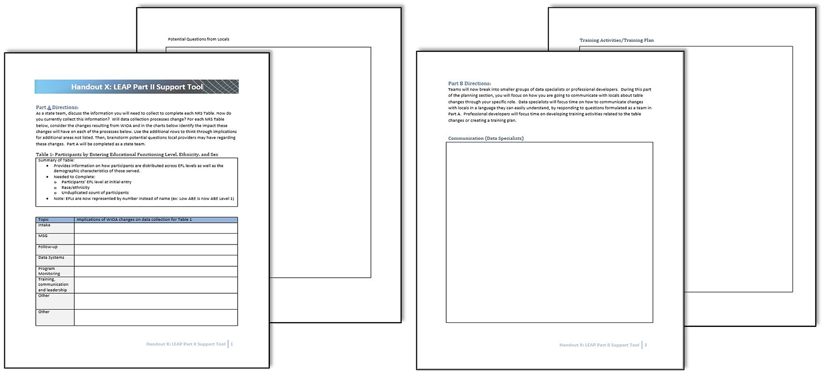
LEAP, Part II: Support Tool
See Handout 1: “LEAP, Part II: Support Tool.”

Slide 11
Elements of the Support Tool
Entry and intake: periods of participation, participants, and intake
MSG and assessment
Following up: employment and credential measures
Data system and reporting changes
Program monitoring
Training, communication, and leadership

Slide 12
Icebreaker Activity

Slide 13
Appreciative Inquiry Introductions
Step 1:
In state teams, identify one or two things related to your state’s implementation of WIOA that you are proud of.
Step 2 (two rounds):
Individually, find someone else in the room you do not know and introduce yourself, your state, your role, and share your state’s accomplishment.
Share-out:
One person from each state will introduce his or her team and accomplishment.

Slide 14
New Vision for Adult Education

Slide 15
How do you see implementation of WIOA affecting the vision for adult education?

Slide 16
WIOA’s Vision
WIOA aims to increase access to and opportunities for employment, education, training, and support services. The act explicitly recognizes the need to coordinate services in order to create a full system of education and training for adults with barriers to employment.
http://sites.ed.gov/octae/2015/05/20/wioa-a-vision-to-revitalize-the-workforce-system/

Slide 17
Combined Vision Under WIOA

Slide 18
Review of Joint Reporting Tables

Slide 19
WIOA Reporting
Uniform accountability under WIOA: data definitions, measures and reporting
Two reporting mechanisms:
Joint statewide reporting template
NRS tables, additional information specific to Title II (adult education)
OCTAE’s data portal will integrate both

Slide 20
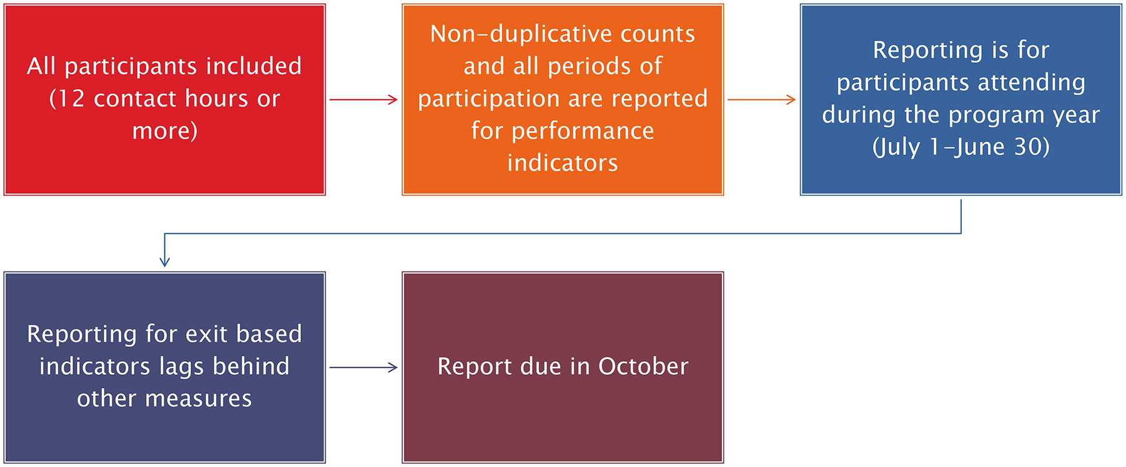
NRS Table Coverage

Slide 21
Statewide Joint Reporting Template
For reporting common WIOA performance measures
Includes total participants and funds expended
Breaks out Measurable Skill Gains and credential types
Breaks out measures by sex, age, ethnicity and 11 categories of barriers or employment

Slide 22
Statewide Joint Performance Report Program information
The Program and Title sections for each joint template will be populated based on the user’s login information.

Slide 23
Statewide Joint Performance Report Summary Information
Sections marked with Green will be automatically populated.
All other sections will need to be entered by the state.
Future guidance may be offered regarding this section of the Statewide Joint Performance Report

Slide 24
Reporting on the Joint ICR
Aggregated performance outcomes broken out by 11 groups and by age, gender, race
Employment rate (second quarter)
Employment rate (fourth quarter)
Median earnings (second quarter)
Credential rate
Measurable Skill Gains rate

Slide 25
Statewide Joint Performance Report Participant Characteristics Section
Date ranges for the sections marked with Green will be automatically populated.
Total Participants Exited will need to be manually entered because the date ranges do not match up with NRS Tables.
Target Num and Rate cells will be manually entered based on the negotiated targets set between the State and OCTAE.
Actual Performance sections, marked in green, will be automatically populated based on the performance data from NRS Tables 4 and 5.

Slide 26
Statewide Joint Performance Report Employment Barriers Section
Total Participants Served cells can not be populated because those characteristics are not accurately disaggregated in the NRS tables.
Date ranges are automatically populated based on the current program year selected by the user.
Cells marked in Green will be automatically populated from NRS Tables.
All other cells will need to have the data manually entered.
Total Participants Exited values will not directly correspond to the follow-up measure percentages.

Slide 27
Participants with Barriers to Employment Under WIOA
New Data Elements: Barriers to Employment
Displaced homemakers
English language learners, low literacy levels, cultural barriers
Exhausting TANF within two years
Ex-offenders
Homeless/runaway youth
Long-term unemployed
Low income
Migrants and seasonal farmworkers
Individuals with disabilities
Single parents
Youth in foster care/aged out of system

Slide 28
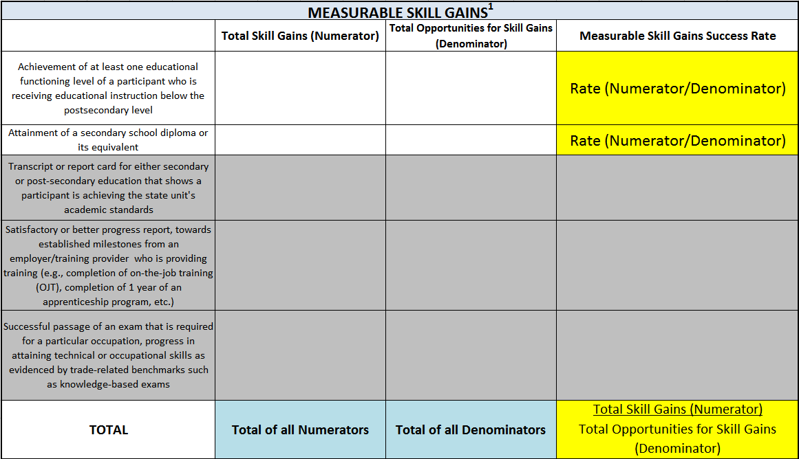
Measurable Skill Gains Template
The Total Skill Gains (Numerator) and Total Opportunities for Skill Gains (Denominator) sections for both credential components must be manually entered based on disaggregated data from NRS Table 5.
The “Total” cell values will be checked against the totals from NRS Table 4 to ensure accuracy.

Slide 29
Credential Attainment Rate Template
All data on this Template are automatically populated from NRS Table 5 or automatically calculated.
No data entry is required by States.

Slide 30
Questions

Slide 31
Break Please return in 15 minutes.

Slide 32
WIOA Performance Reporting in the NRS
Six Key Issues

Slide 33
Six Key Issues
Participants and reportable individuals
Program entry and exit, and periods of participation
Employment performance indicators
Measurable Skill Gains (MSG)
Credential attainment indicator
Participant exclusions from indicators
See Handout 2: “NRS Tips: NRS Performance Measures Under WIOA.”

Slide 34
Participants and Reportable Individuals
Participant:
Only upon achieving 12 contact hours after program entry
Reported on NRS and Statewide Performance Report tables
Count toward performance measures
Reportable Individual:
Provides identifying information
Taken action that demonstrates an intent to use program services
Has less than 12 contact hours

Slide 35
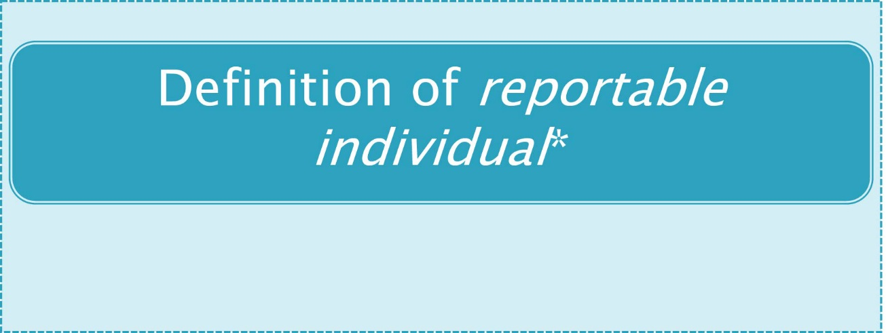
Participants and Reportable Individuals
What’s New?
What’s Not?
*Not reported now; may be in in a future table
See Handout 3: “What’s New, What’s Not.”

Slide 36
Six Key Issues
Participants and reportable individuals
Program entry and exit, and periods of participation
Employment performance indicators
Measurable Skill Gains (MSG)
Credential attainment indicator
Participant exclusions from indicators

Slide 37
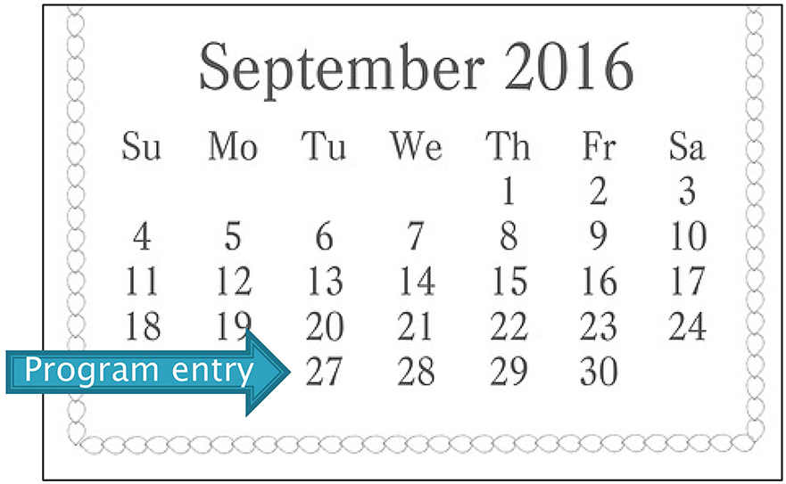
Program Entry
Program entry—the date on which a reportable individual enrolls in an adult education and family literacy program

Slide 38
Program Exit
Program exit occurs when the participant has not received services for the past 90 days and has no additional services scheduled. The date of exit is the last date on which the participant receives services.
However, the exit date service cannot be determined until at least 90 days have elapsed since the participant last received services.

Slide 39
Period of Participation (PoP)
Every entry is counted as a period of participation, even if it occurs during the same program year
Participants with more than one program entry will have multiple periods of participation in a program year.

Slide 40
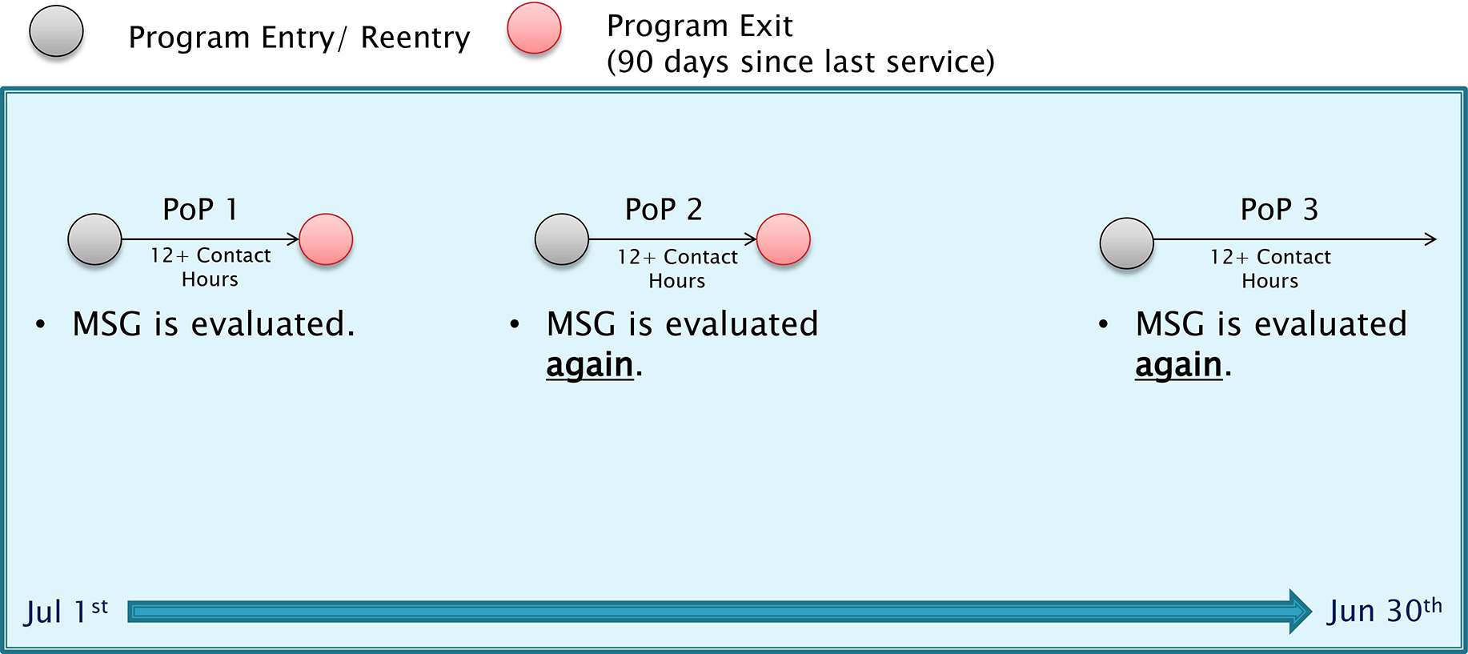
Periods of Participation (POP) MSG Indicator Example

Slide 41
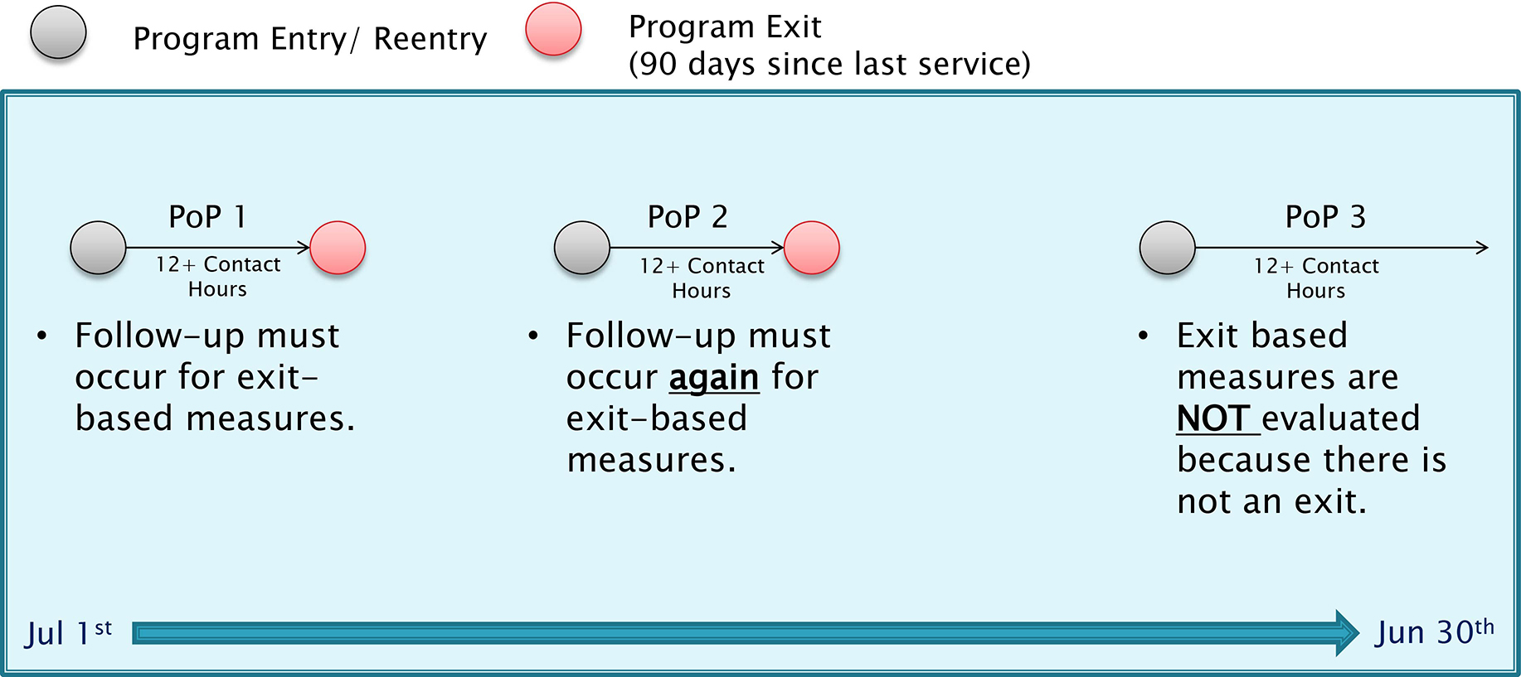
Periods of Participation (POP) Follow-Up Indicators Example

Slide 42
Periods of Participation - Implications

Slide 43
Program Entry and Exit, and Periods of Participation
What’s New?
What’s Not?

Slide 44
Jeopardy!
Directions: Open the Jeopardy file on ONE computer at each table. Assign one person to facilitate the game. Discuss responses as needed.
Program Entry and Exit, and Period of Participation

Slide 45
Six Key Issues
Participants and reportable individuals
Program entry and exit, and periods of participation
Employment performance indicators
Measurable Skill Gains (MSG)
Credential attainment indicator
Participant exclusions from indicators

Slide 46
Employment Performance Indicators

Slide 47
Employment Performance Indicators, cont’d

Slide 48
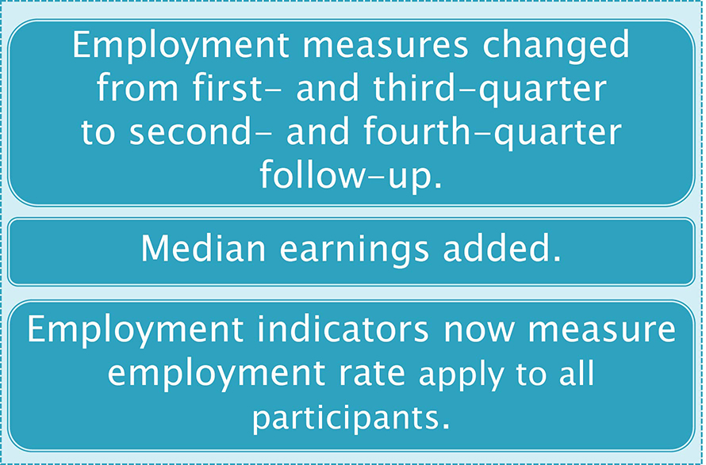
Employment Performance Indicators, cont’d
What’s New?
What’s Not?

Slide 49
Jeopardy!
Directions: Open the Jeopardy file on ONE computer at each table. Assign one person to facilitate the game. Discuss responses as needed. .
EMPLOYMENT PERFORMANCE INDICATORS

Slide 50
Lunch Please return in 1 hour

Slide 51
Six Key Issues
Participants and reportable individuals
Program entry and exit and periods of participation
Employment performance indicators
Measurable Skill Gains (MSG)
Credential attainment indicator
Participant exclusions from indicators

Slide 52
Measurable Skill Gains (MSG)
Five types of gain to measure progress toward academic, technical or occupation credential, or employment
Two types of gain apply to adult education:
Educational functioning level gain—three ways to document EFL gain
Receipt of a secondary credential

Slide 53
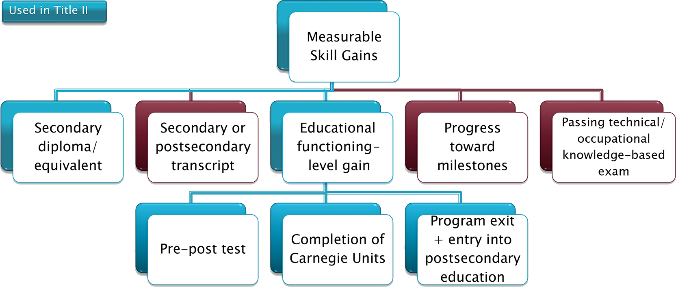
Five Types of Measurable Skill Gains for WIOA

Slide 54
Educational Functioning-Level Gain
An educational functioning level (EFL) gain may be measured by the following:
Comparing the participant’s pretest with the participant’s posttest, using an NRS approved test
Awarding of Carnegie Units or credits in an adult high school program
Enrollment in postsecondary education and training after exit

Slide 55
Counting Measurable Skill Gains
Counting Measurable Skill Gains
All participants are included for MSG for each period of participation.
Only one type of gain can be counted for each participant per period of participation, the last achieved.
Entry into postsecondary education is measured only after participant exits.
Receipt of secondary credential and entry into postsecondary education must occur by the end of the program year (June 30).
Participants in adult high school can complete Adult Basic Education (ABE) Level 5 by earning enough Carnegie Units or credits to move to 11th- or 12th-grade status according to state rule.

Slide 56
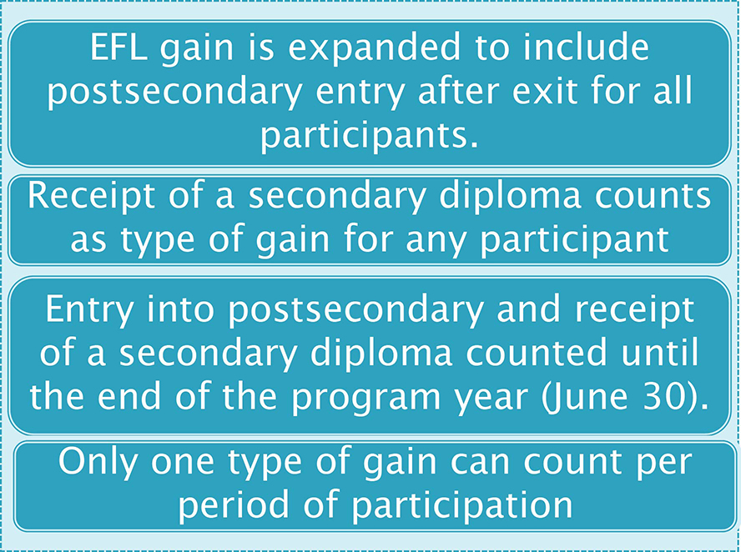
Measurable Skill Gains
What’s New?
What’s Not?

Slide 57
Jeopardy!
Directions: Open the Jeopardy file on ONE computer at each table. Assign one person to facilitate the game. Discuss responses as needed.
Measurable Skill Gains

Slide 58
Six Key Issues
Participants and reportable individuals
Program entry and exit, and periods of participation
Employment performance indicators
Measurable Skill Gains (MSG)
Credential attainment indicator
Participant exclusions from indicators

Slide 59
Credential Attainment Indicator
Two components of Credential Attainment Indicator:
Secondary credential attainment
Postsecondary credential attainment
Percentage of participants who obtain a secondary school diploma or recognized equivalent or a recognized postsecondary credential, while enrolled or within one year of exit

Slide 60
Credential Attainment Indicator, cont.
But: A participant who has attained a secondary school diploma for the Credential Attainment Indicator is counted only if the participant is employed or enrolled in a postsecondary education or training program within one year of exit

Slide 61
Credential Attainment Indicator: Secondary Credential
The secondary credential component of the Credential Attainment Indicator is limited to participants who
did not previously possess a high school equivalency and entered at or above the 9th grade level;
OR who advance to the 9th grade or higher level during a period of participation;
and exited from the secondary education program.

Slide 62
Credential Attainment Indicator: Postsecondary Credential
The postsecondary education component of the Credential Attainment Indicator is limited to participants who
were enrolled in a postsecondary education or training program, including an integrated education and training (IET) program;
and exited from the postsecondary education or training program.

Slide 63
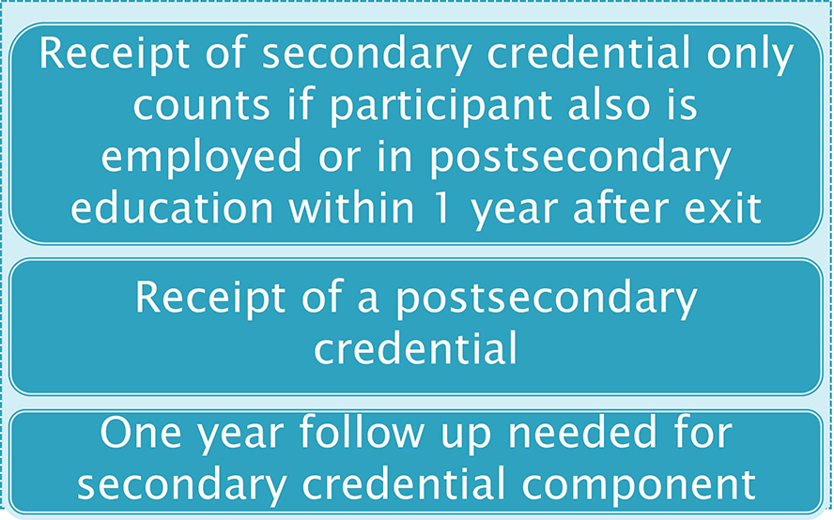
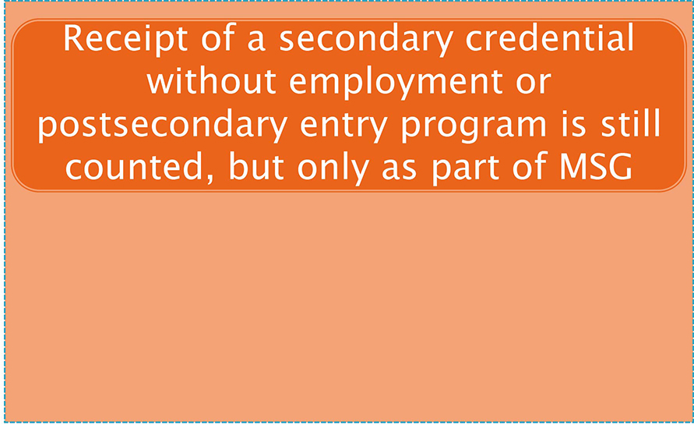
Credential Attainment Indicator
What’s New?
What’s Not?

Slide 64
Jeopardy!
Directions: Open the Jeopardy file on ONE computer at each table. Assign one person to facilitate the game. Discuss responses as needed.
CREDENTIAL ATTAINMENT INDICATOR

Slide 65
Six Key Issues
Participants and reportable individuals
Program entry and exit, and periods of participation
Employment performance indicators
Measurable Skill Gains (MSG)
Credential attainment indicator
Participant exclusions from indicators

Slide 66
Participant Exclusions
The following reasons for EXIT allow the exclusion of a participant from ALL performance indicators:
Exit is due to the participant becoming incarcerated or entered into a 24-hour support facility such as a hospital or treatment center
Exit is due to medical treatment that lasts more than 90 days
Participant is deceased
Exit is due to being called into active duty in the National Guard or other armed services for at least 90 days

Slide 67
Corrections Exclusions
Participants in a correctional institution under section 225 of WIOA who remain incarcerated after exit are included in the MSG indicator, but excluded from:
2nd Quarter Employment Indicator
Median Earnings Indicator
4th Quarter Employment Indicator
Credential Indicator

Slide 68
Jeopardy!
Directions: Open the Jeopardy file on ONE computer at each table. Assign one person to facilitate the game. Discuss responses as needed.
PARTICIPANT EXCLUSIONS FROM INDICATORS

Slide 69
Six Key Issues Check-In

Slide 70
Policy to Practice

Slide 71
Policy to Practice
NRS table changes! Reporting changes! Go!

Slide 72
Communicating With Locals
. . . It’s not what you want them to know; it’s what they want to know from you.

Slide 73
Questions to Consider
What is our goal?
How can our messages be helpful to our audience?
What background knowledge does the audience have about our topic?
What would be the reaction of our audience? Why?
What related issues are important to our audience?
See Handout 4: “Communication Guidance.”

Slide 74
Activity Directions
Teams will be assigned ONE aspect of WIOA accountability policy change that you will communicate to your local providers.
Review the “Communication Guidance” handout.
Discuss the topic with your team.
Then write the message in your own words.
Individuals will share feedback, and then teams will update language.
Write team’s final message on chart paper.
Activity outcome:
Each group will develop a message; then all states can benefit and take all messages with them!

Slide 75
Activity Topics: Key Issues (1)
Participants and reportable individuals
What are the differences between participants and reportable individuals? Why are the differences important?
Program entry and exit and periods of participation
How do you determine program entry and exit?
What does period of participation mean? What are the implications of it?
Employment performance indicators
What are employment performance indicators and what is the time lag for collecting that information?
Who can be excluded from exit-based indicators such as employment?
See Handout 5: 6 Key Issues Activity

Slide 76
Activity Topics: Key Issues (2)
Measurable Skill Gains (MSG)
What is a Measurable Skill Gains? What are the different types of gain under MSG?
How should MSG be measured?
Credential attainment indicator
What is a credential attainment indicator and who does it apply to?
Participant exclusions from indicators
Who may be excluded from indicators?

Slide 77
Messaging Feedback
Part I (individual)
Review each message.
Provide suggested edits and ask clarifying questions. Use “Questions to Consider” to guide your feedback.
Use Post-its to provide your feedback.
Part II (original group)
Respond to questions and consider suggested edits.
Write final communication on chart paper.

Slide 78
NRS Table Changes and Reporting Requirements
Tables 1, 2, and 3

Slide 79
Table 1: Participants, by Entering Educational Functioning Level, Ethnicity, and Sex
Purpose: Provides number of participants by educational functioning level (EFL), race/ethnicity, and sex.
Use: Provides information on the way participants are distributed across levels and demographic characteristics of those served.

Slide 80
Table 1, cont’d
How to complete the table:
Use participants’ EFL at initial entry.
Race/ethnicity is self-reported or determined by staff through observation.
Report the unduplicated count of all participants—no missing data is permitted.

Slide 81
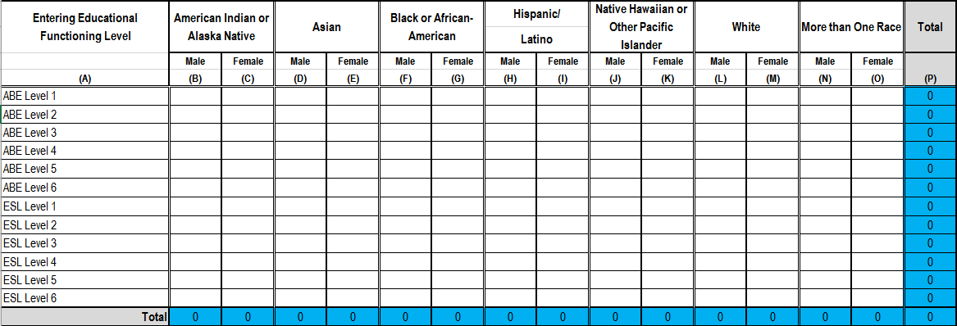
Table 1. Participants, by Entering Educational Functioning Level, Ethnicity, and Sex

Slide 82
Table 1: What’s New
EFL names are changed to Levels 1, 2, 3, 4, 5, and 6 to accommodate possible changes from new descriptors.

Slide 83
Table 2. Participants, by Age, Ethnicity, and Sex
Purpose: Provides number of participants, broken down by race/ethnicity and sex, by age group
Use: Provides information on the way participants are distributed according to demographic characteristics

Slide 84
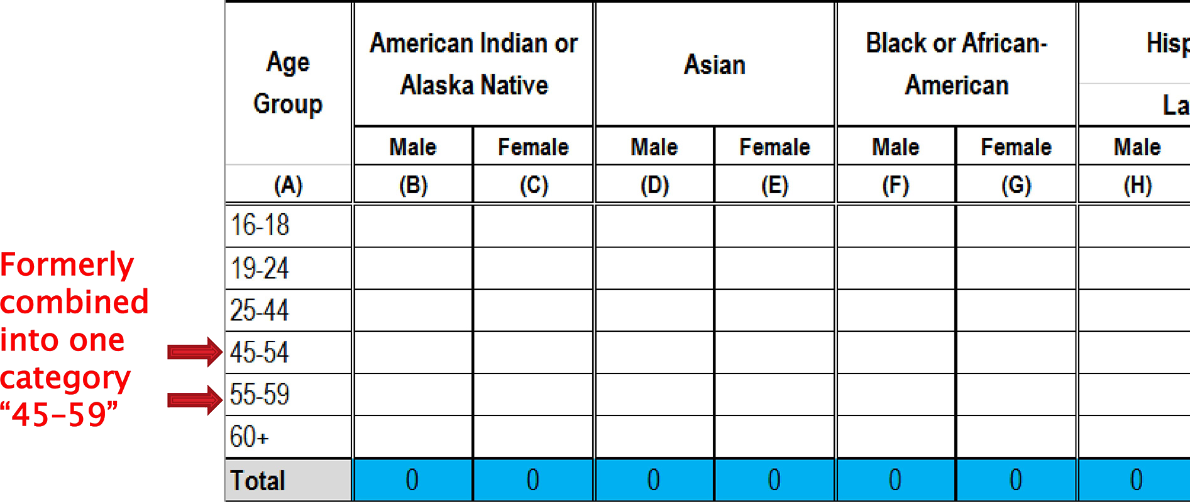
Table 2. Participants, by Age, Ethnicity, and Sex: Changes

Slide 85
Table 2, cont’d
How to complete the table:
Use participant status at initial entry.
Race/ethnicity is self-reported or determined by staff through observation.
Report unduplicated count of all participants—no missing data is permitted.
Totals must match those in Table 1.

Slide 86
Table 2: What’s New
New age category

Slide 87
Table 3. Participants, by Program Type and Age
Purpose: Provides participant numbers, broken down by age and instructional program type, including integrated education and training.
Use: Provides information on participant age distribution across instructional program type and numbers of students in IET for each program; provides picture of number of participants in Sec. 243 IET/EL Civics.

Slide 88
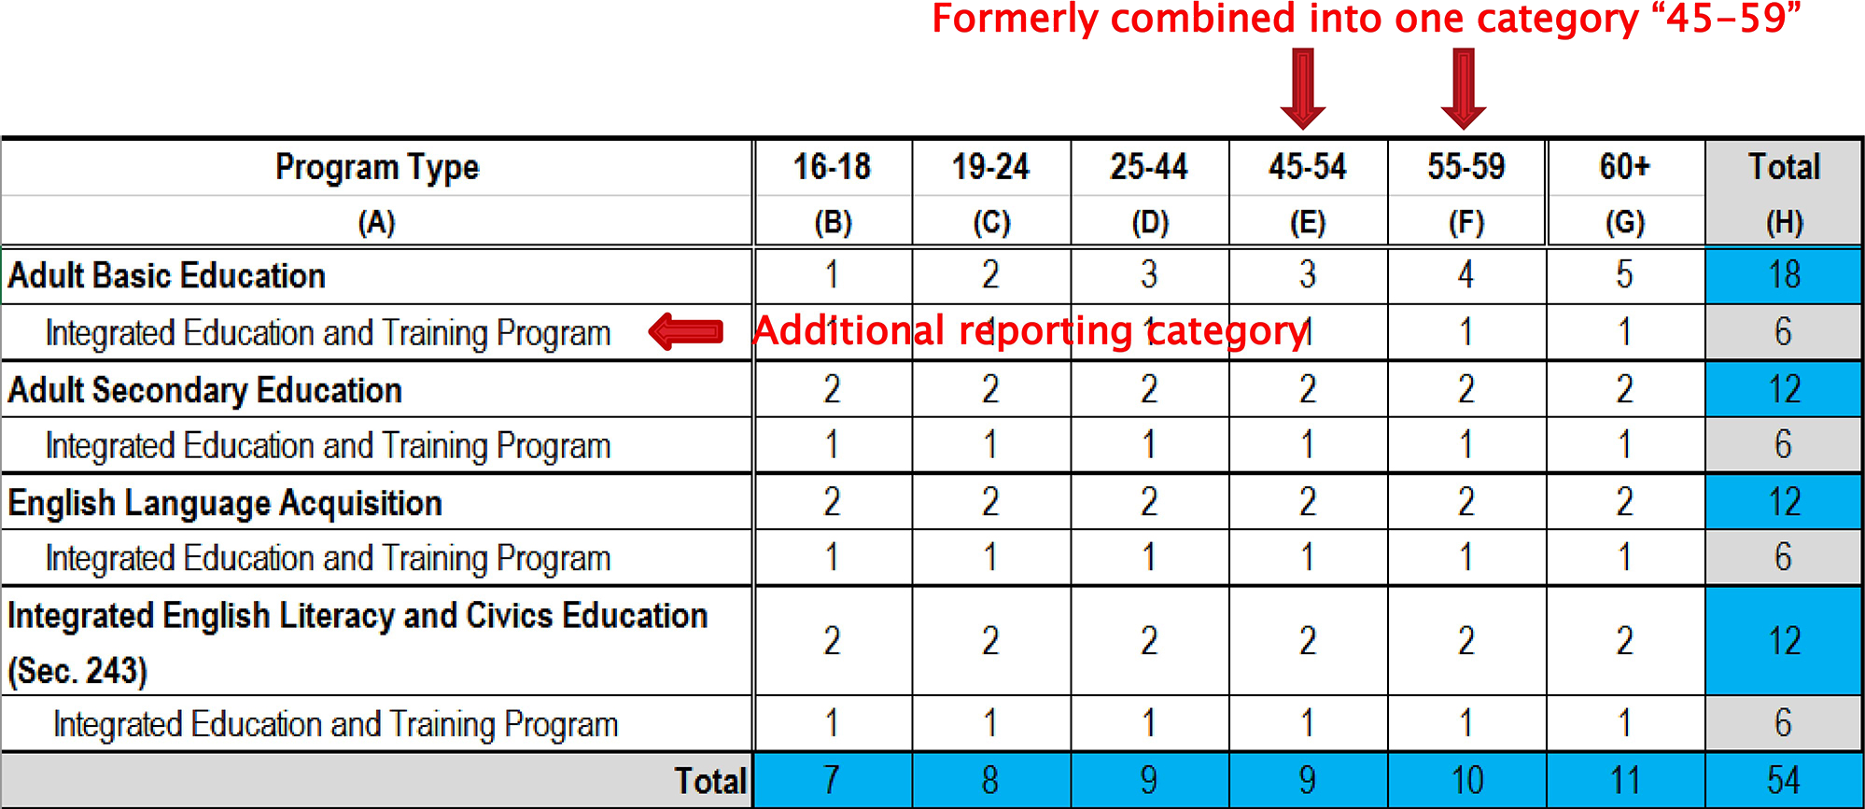
Table 3. Participants, by Program Type and Age: New Categories

Slide 89
Table 3, cont’d
How to complete the table:
Use program in which participant is placed at initial entry.
Break out subset of IET participants separately for each program.
Age is self-reported or determined by staff through observation.
Report unduplicated count of all participants—no missing data is permitted.
Totals must match those in Table 1.

Slide 90
Table 3: What’s New
New age category
IET breakdown by instructional program type, including IET/EL Civics
Name change of ESL to English language acquisition for WIOA reporting

Slide 91
Changes in Action
A participant enrolls in an IET program. Can this entry be considered enrollment in postsecondary education for MSG? Why or why not?
Scenario: Jane enters ABE Level 3 in July 2016, gets 10 hours, and leaves. She returns in September 2016, gets 40 hours, and exits at the end of the month. She then returns in January 2017, gets 80 hours, and is still there at end of year.
How many periods of participation does Jane have?
When is her exit date for each period of participation?
See Handout 6: “NRS Table Changes in Action.”

Slide 92
Break Please return in 15 minutes.

Slide 93
State Planning Time

Slide 94
State Planning Time Overview
State planning
Teams splitting up and working on communication and professional development
Cross-state sharing
Gallery Walk
See Handout 1: “LEAP, Part II: Support Tool.”

Slide 95
State Planning Time, Part A
Focus on the table changes and reporting requirements presented.
Identify the impact of these changes in relation to the following:
Intake
Broader assessment (MSG)
Follow-up
Data systems
Program monitoring
Training, communication, and leadership
What questions will the locals have?

Slide 96
State Planning Time, Part B
Focus on how you are going to communicate with locals about table changes.
You will develop responses to questions formulated in the previous planning activity, according to your role in the state.
Activity outcome:
We will compile teams’ work into a “Ready-to-Use FAQ Packet” and all states can benefit from the shared materials.

Slide 97
State Planning Time, Part B
Communicating with locals (data staff) | Training activity development (PD staff)
Develop responses to questions from locals to help them understand how to collect the required data. Remember your audience! | Develop at least one training activity that will help locals understand the tables. Create scenarios or work on a training plan!

Slide 98
Wrap-Up

Slide 99
Day 2 Overview
NRS Tables 4-5
NRS Tables 6, 7, 8, 9, 10, and 14
Time Line for Reporting Indicators
Cross-State Sharing
State Planning Time

Slide 100
Day 1 Reflection—What Stuck With You?

